Slide 1
The New Physical Items Experience (Q4 2026)
Yoel Kortick
Yoel.Kortick@clarivate.com

Slide 2
  Introduction
  Faster Access to Search Results
  Editing Items in Search Results
  Perform More Actions Directly from the Search Results
  The New UX Views
  Facets
  Sorting Search Results
  Secondary Search
  Labels
  The Holdings' Items List
  The Title's Items List
  Configurable Display
  The New Item View
  Editing An Item
Agenda

Slide 3
Introduction

Slide 4
Introduction
Over the past several releases, Alma has introduced significant enhancements to the Staff User Interface, designed to improve usability and productivity.
Key Benefits
  Faster, more intuitive search capabilities
  Simplified and streamlined workflows
  Increased efficiency for frequently used tasks and processes
  An improved overall user experience

Slide 5
Introduction
As part of the Physical Items User Interface improvement initiative, special emphasis has been placed on improving the user experience in the following areas:
  Physical Items Search
  Items List Management
  Item Viewing and Editing

Slide 6
Faster Access to Search Results

Slide 7
Faster Access to Search Results
Faster Access to Search Results
  Results are displayed progressively as information becomes available
  Users can begin working immediately without waiting for all data to load
  Additional details are added dynamically in the background
  Consistent with the modern search experience introduced for title searches

Slide 8
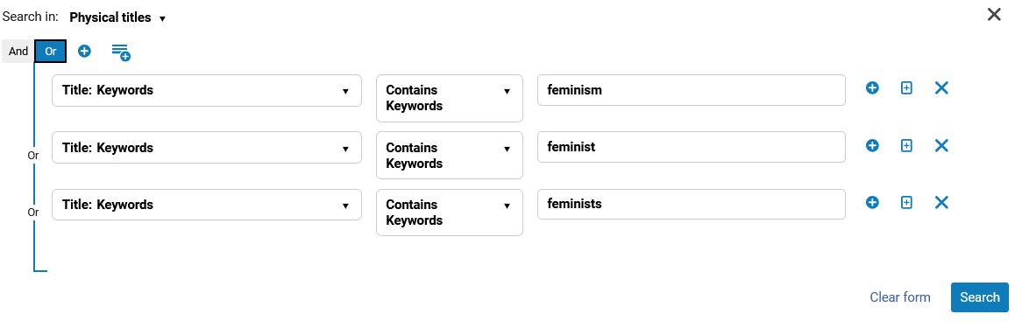
Faster Access to Search Results
Here for example, we will perform a physical titles advanced search for "keywords contains keywords feminism OR "keywords contains keywords feminist OR "keywords contains keywords feminists"

Slide 9
Faster Access to Search Results
On the next two slides we will see that
First the facet pane and the records list will load, and they can be used.
  For example, facets can already be applied
A few moments later the record view also loads.
The staff user does not need to wait for the entire page to load to perform an action such as applying facets.

Slide 10
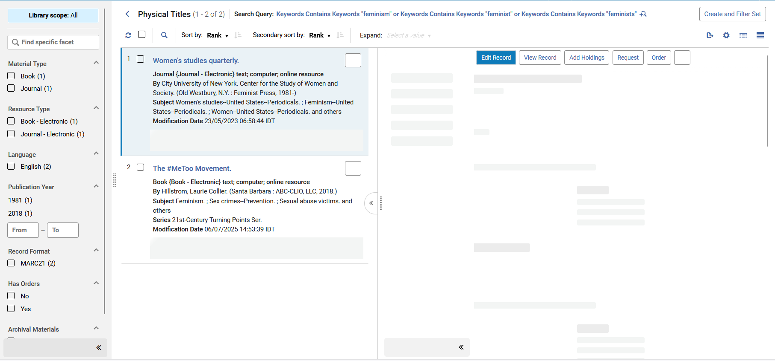
Faster Access to Search Results
The record view has not yet loaded
Both facet pane and record list loaded and displays. They can both be used by the staff user.

Slide 11
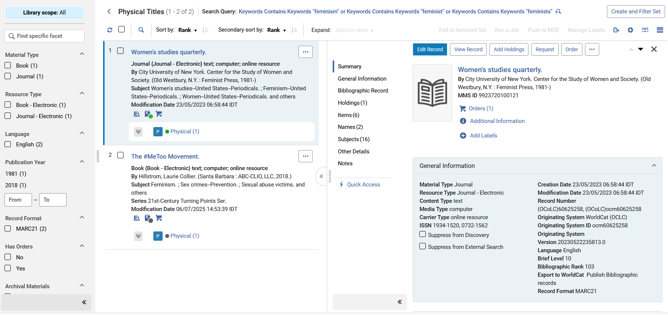
Faster Access to Search Results
Now everything has loaded

Slide 12
Editing Items in Search Results

Slide 13
Editing Items in the Search Results
Users with appropriate roles and privileges can edit physical items while remaining in the search context, using the new item editor in a side-by-side or full view.
For more information on the new editor, see The New Item View and Editor.

Slide 14
Editing Items in the Search Results
On the next slide we are in the physical items repository search results focusing on one of the results which is title "Women's studies quarterly", Barcode 2233445566, v.10:no.1(2017).
We will click the pencil to edit.
What happens now:
  Clicking the pencil to edit allows the staff user to edit the physical item while still in the repository search results
  The staff user hence does not lose his or her context of where he or she is.
What happened in the previous User Interface:
  Clicking edit removed the staff user from the context of the repository search results and opened a separate screen with the physical item editor.
  The staff user hence would lose his or her context of where he or she was.

Slide 15
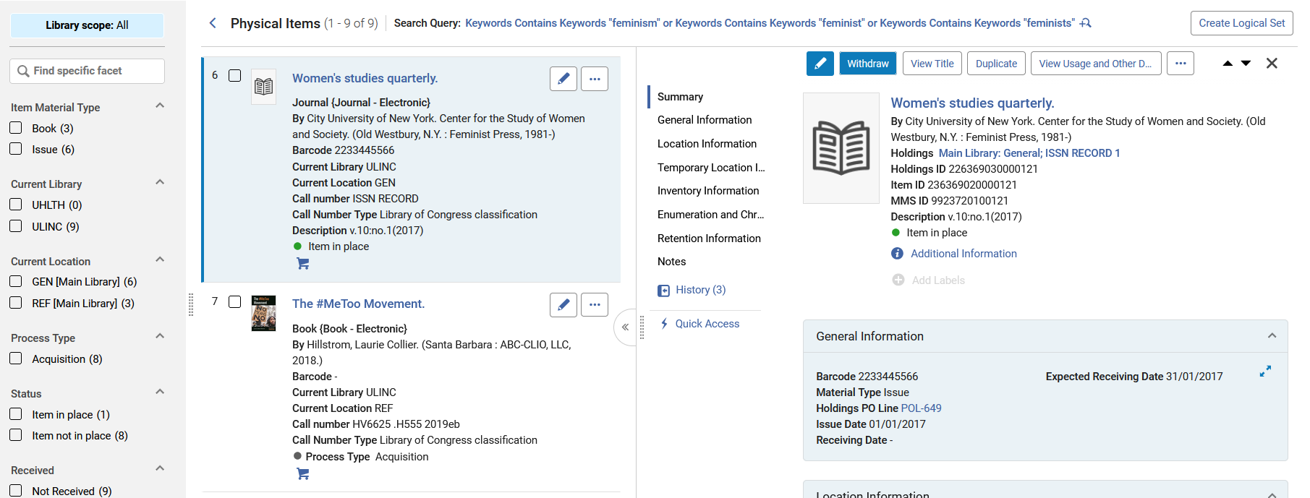
Editing Items in the Search Results
We will click the pencil here to edit the item

Slide 16
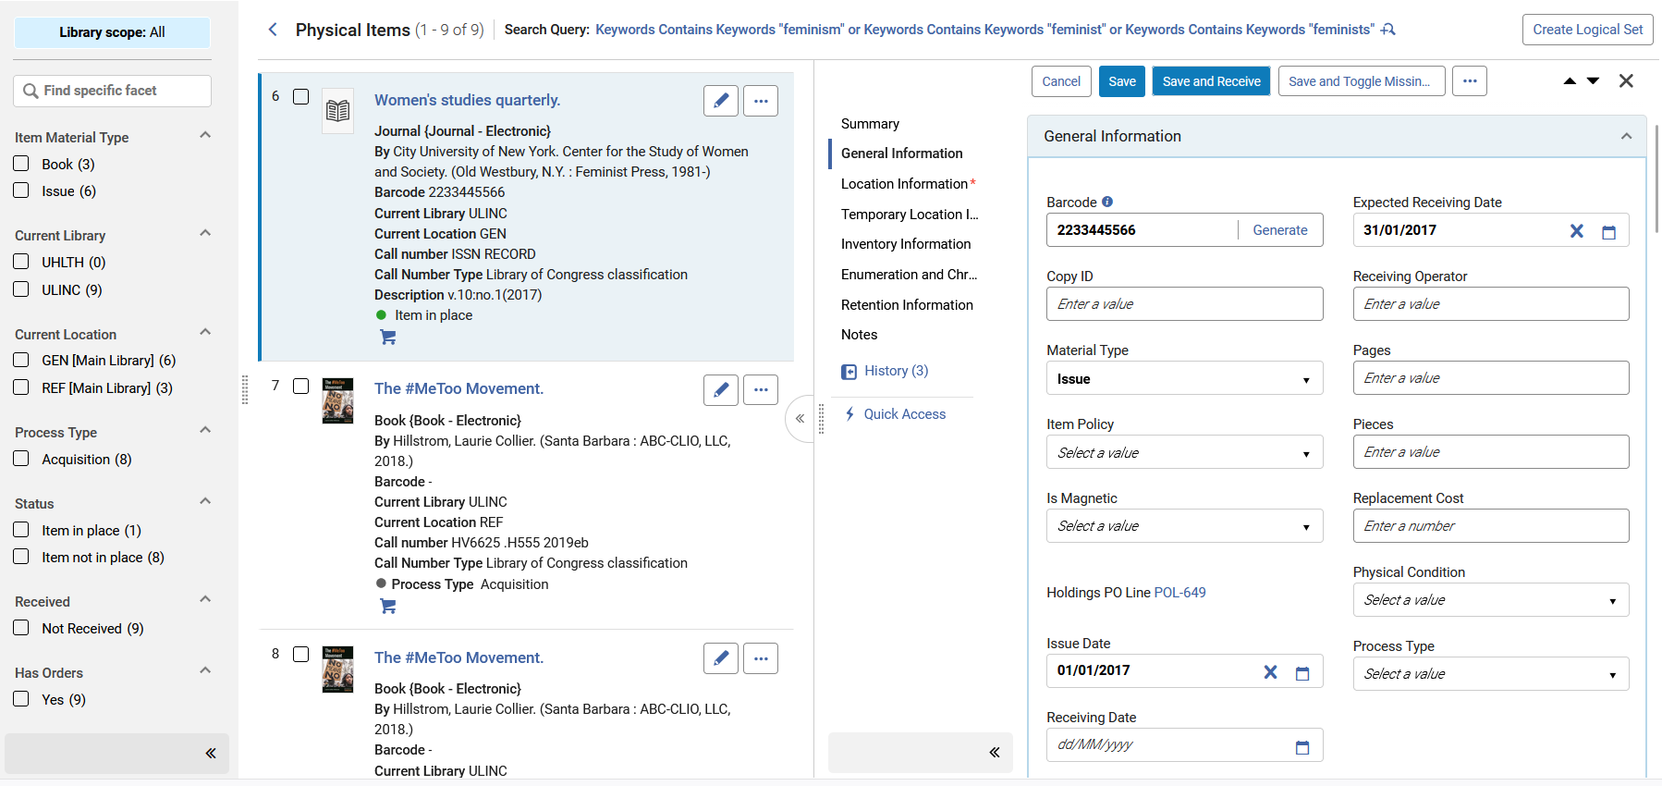
Editing Items in the Search Results
The item now becomes editable while still in the search results

Slide 17
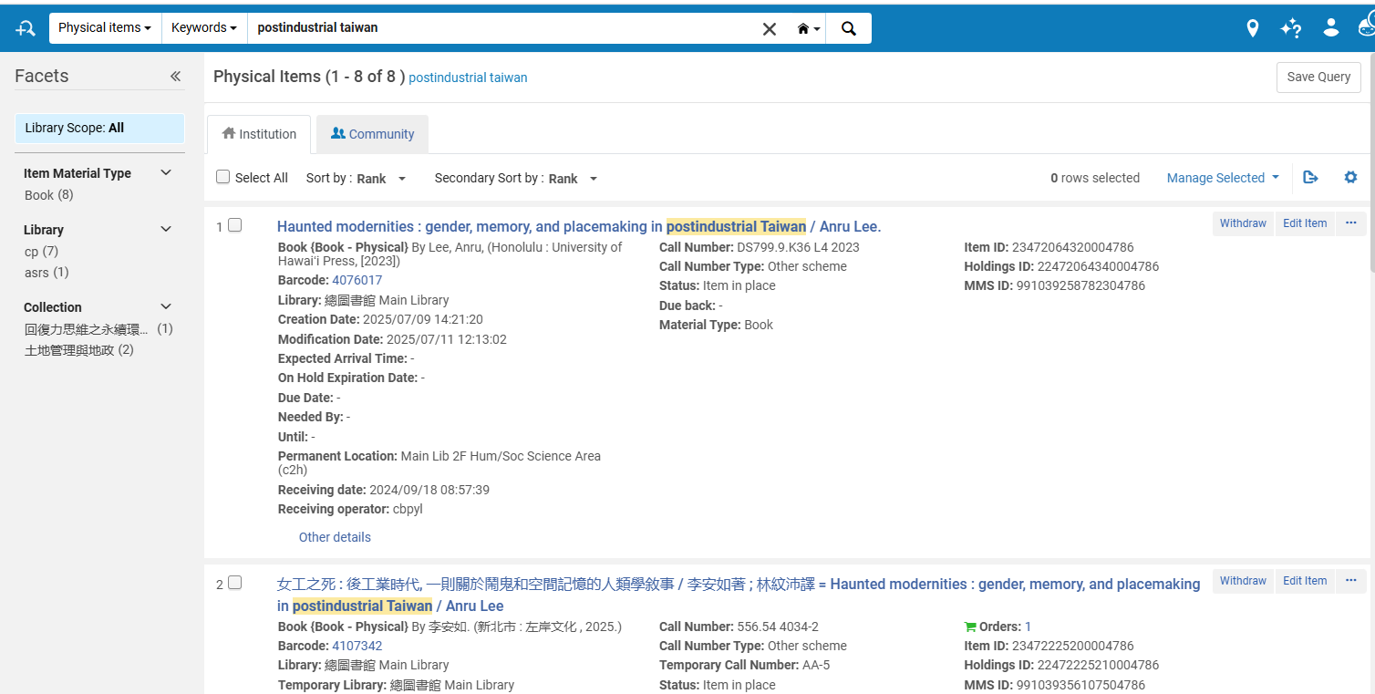
Editing Items in the Search Results
If we click "edit" from the physical items repository search results in the previous User Interface:

Slide 18
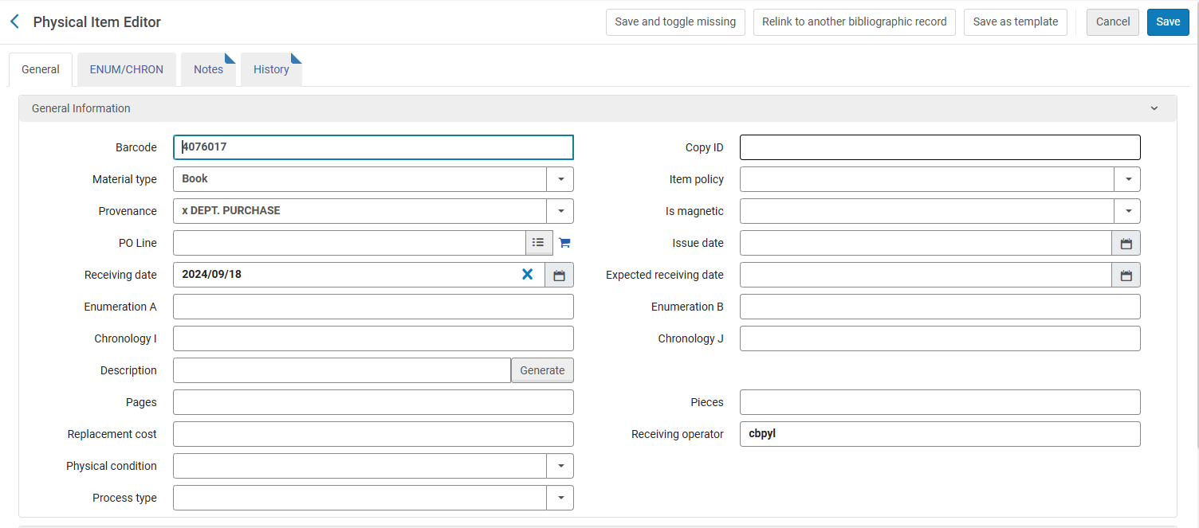
Editing Items in the Search Results
Then we will be removed from the context of the repository search results and sent to a new screen with the physical items editor.

Slide 19
Perform More Actions Directly from the Search Results

Slide 20
Perform More Actions Directly from the Search Results
Perform More Actions Directly from the Search Results
  Users can now perform many item management actions directly from search results and related item views.
  This eliminates the need to navigate to other screens.
  Examples include:
    Relink to Another Bibliographic Record
    Save as Template
    View Fulfillment History
  Result: Faster, more efficient item management workflows.

Slide 21
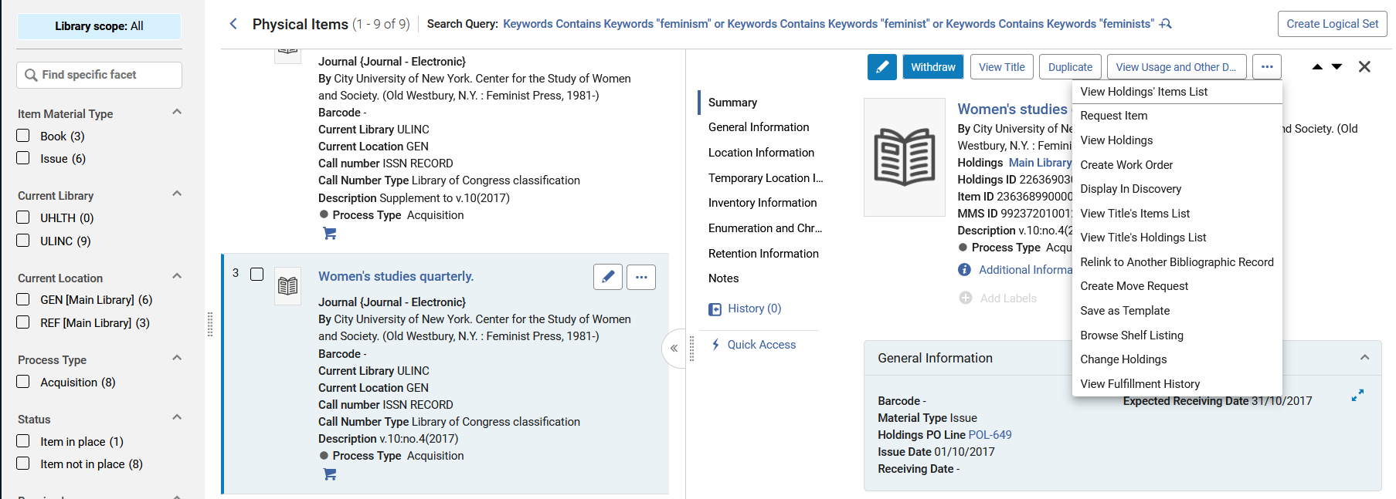
Perform More Actions Directly from the Search Results

Slide 22
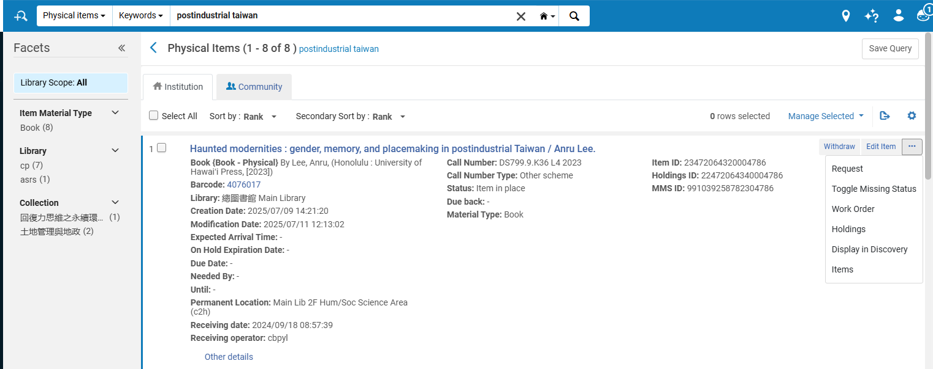
Perform More Actions Directly from the Search Results
In the previous User Interface these options did not appear in the repository search results

Slide 23
Perform More Actions Directly from the Search Results
Perform More Actions Directly from the Search Results
  Users can now perform many item management actions directly from search results and related item views.
  This eliminates the need to navigate to other screens.
  Examples include:
    Relink to Another Bibliographic Record
    Save as Template
    View Fulfillment History
  Result: Faster, more efficient item management workflows.

Slide 24
Perform More Actions Directly from the Search Results
Navigation actions were added for easy access to the entities above and around the item.
The navigation actions open a sliding panel, keeping users in context and allowing them to perform more complex operations as a "side quest" without moving to other areas in Alma.
When done performing a specifci activity the user seamlessly returns to the list of items to continue his ir her main work once he or she is done.

Slide 25
Perform More Actions Directly from the Search Results
View Title: Opens the full details of the item’s bibliographic record, including the ability to perform actions on the title and its inventory (according to the user’s roles).
View Holdings: Opens the full details of the item’s holdings record, including the ability to perform actions on the title and its inventory (according to the user’s roles).
View Holdings’ Items List: Opens the items list to show the other items under the same holdings, to assess the completeness of the holdings and easily perform actions in the list context (e.g., binding).
View Title’s Items List: Opens the items list to show all items under the same bibliographic record.
View Title’s Holdings List: Opens the holdings list to display all holdings under the same bibliographic record, making it easy to review holdings, their items, etc.

Slide 26
Perform More Actions Directly from the Search Results

Slide 27
The New UX Views

Slide 28
The New UX Views
Alma's modern user experience is designed to help users stay focused on their work by reducing the need to navigate between screens when viewing information or performing tasks.
Key Benefits
  Keep workflows within a single working context
  Reduce unnecessary navigation and clicks
  Improve efficiency and productivity
  Choose from multiple views to match individual work preferences
  Easily switch between item views as needed
Result: A more intuitive, flexible, and efficient user experience.

Slide 29
The New UX Views
The New UX Views include:
List View: Provides a brief item display for each item (also called "Record View").
Table View: Displays limited information in a convenient table for easy comparison.
Split View: Shows the items on the left, side by side with the focused item’s full record in view/edit mode.
Full Page View: When focusing on an item, it displays the full record only, in view/edit mode side-pane only, offering more space for details.

Slide 30
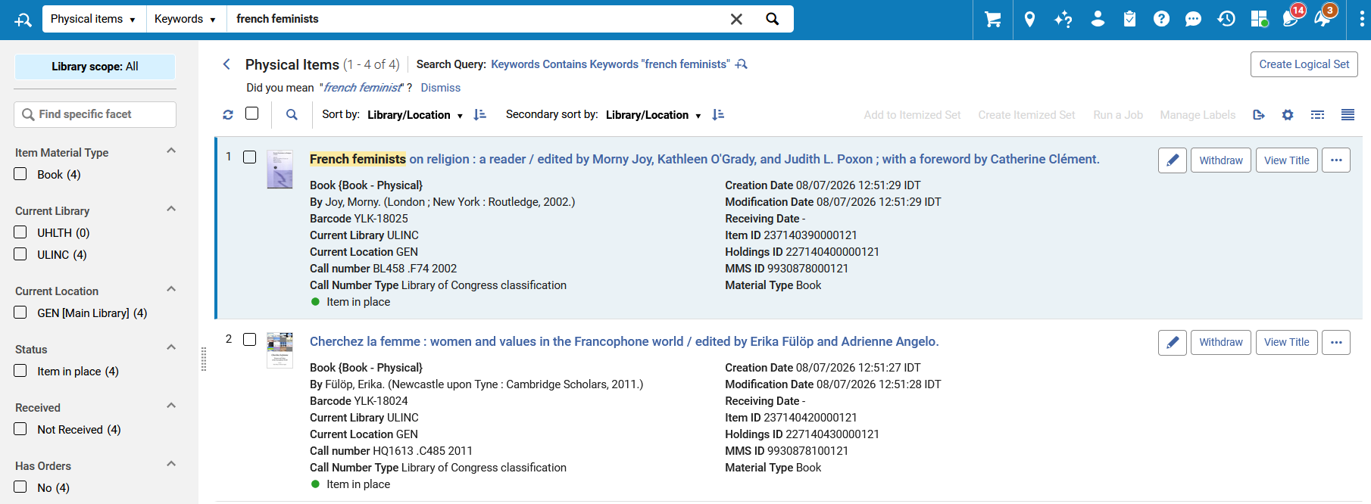
The New UX Views
List View: Provides a brief item display for each item.

Slide 31
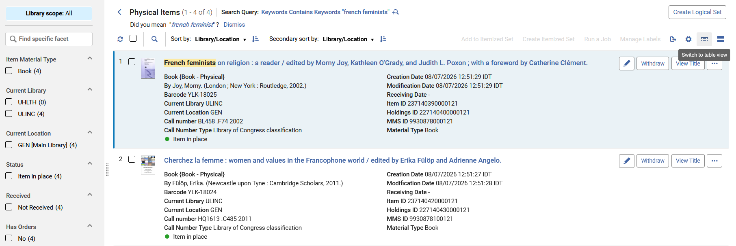
The New UX Views
Table View: Displays limited information in a convenient table for easy comparison.
We will now switch from List View to Table View

Slide 32
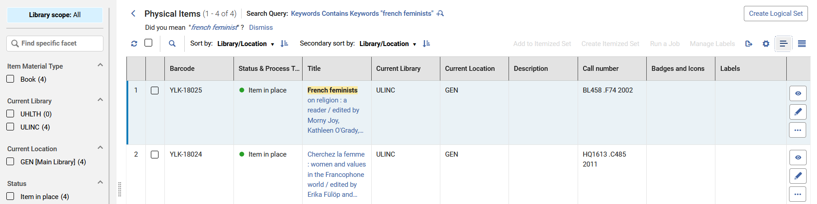
The New UX Views
Table View: Displays limited information in a convenient table for easy comparison.

Slide 33
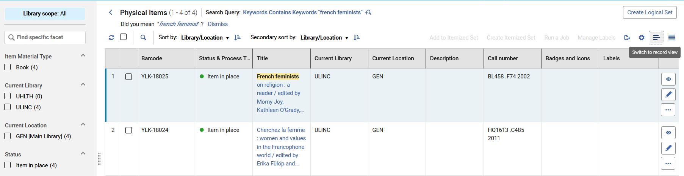
The New UX Views
Table View: Displays limited information in a convenient table for easy comparison.
From the Table View we can switch back to List View

Slide 34
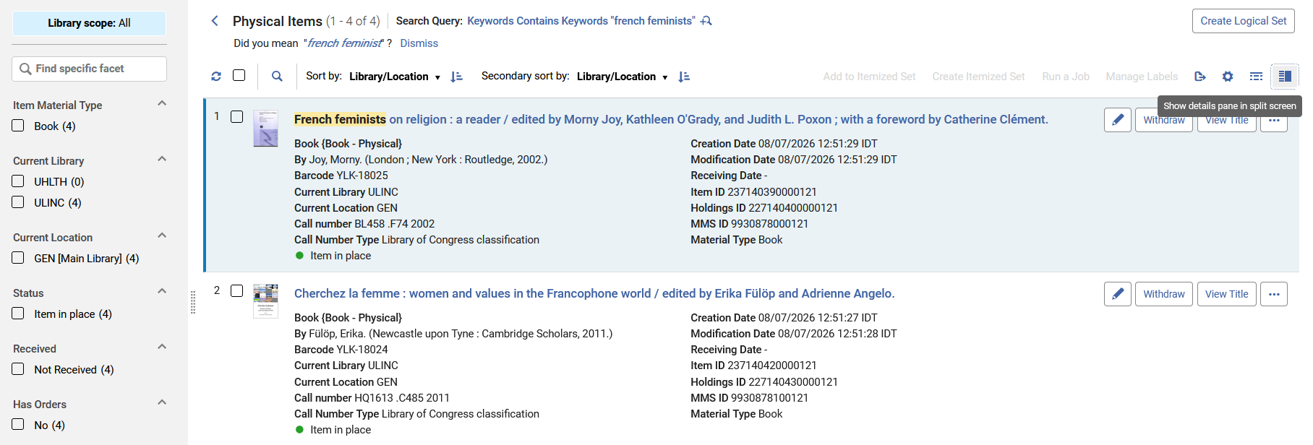
The New UX Views
Split View: Shows the items on the left, side by side with the focused item’s full record in view/edit mode.
From the List View we can switch to Split View

Slide 35
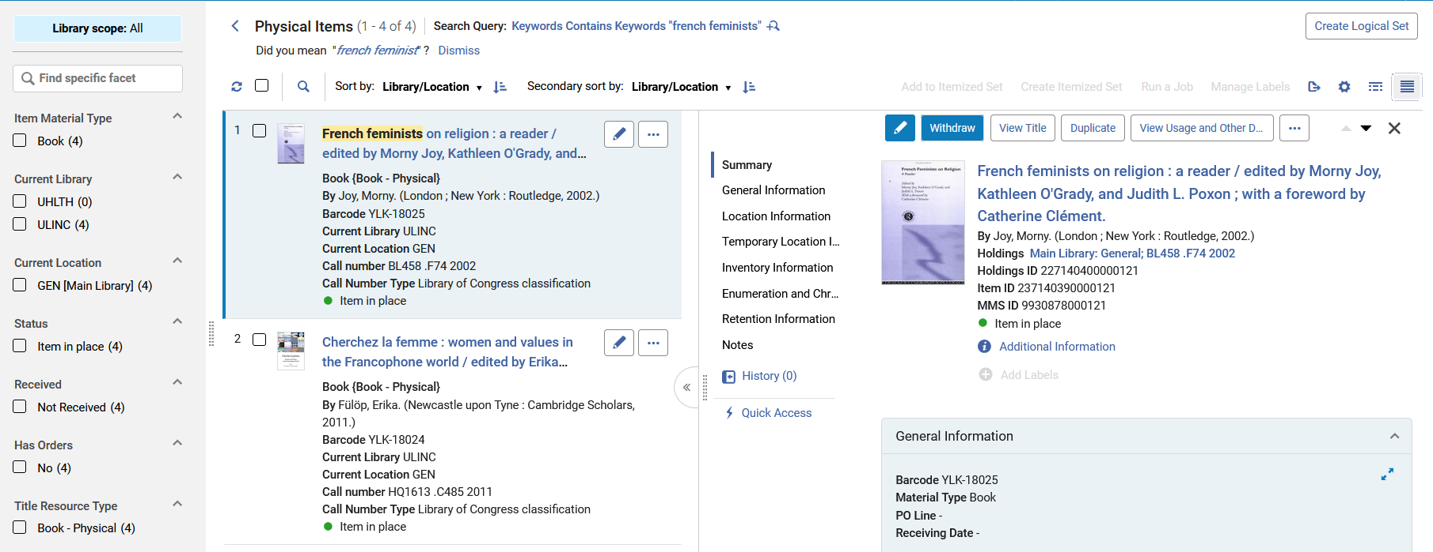
The New UX Views
Split View: Shows the items on the left, side by side with the focused item’s full record in view/edit mode.
focused item’s full record

Slide 36
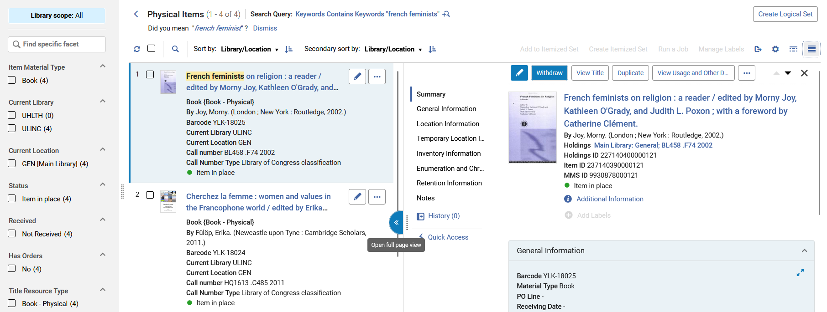
The New UX Views
Full Page View: When focusing on an item, it displays the full record only, in view/edit mode side-pane only, offering more space for details.
From the Split View we can switch to Full Page View

Slide 37
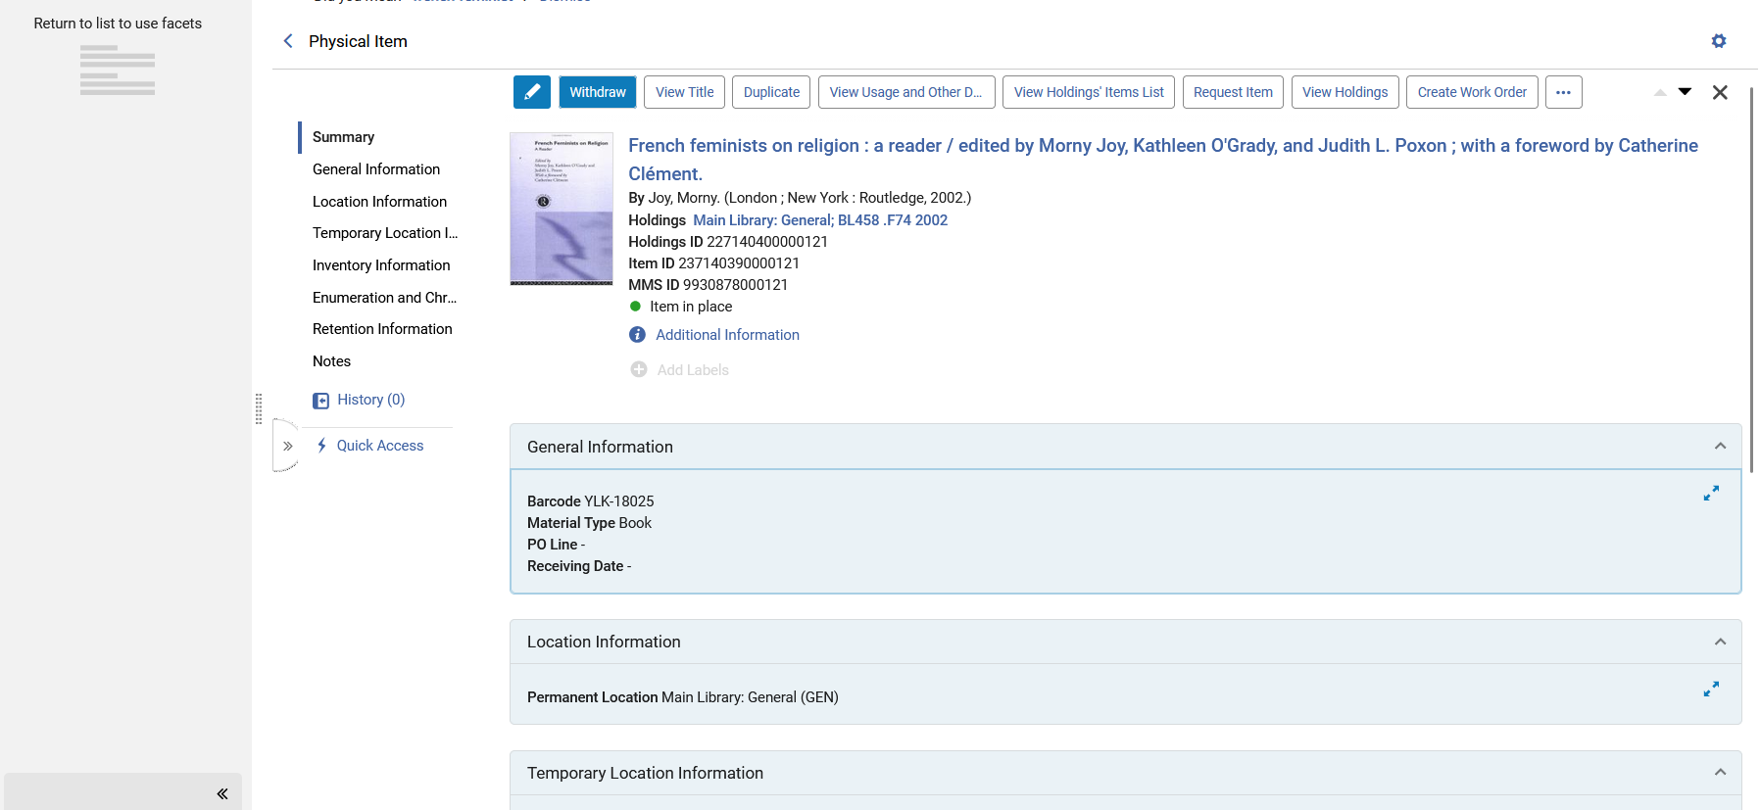
The New UX Views
Full Page View: When focusing on an item, it displays the full record only, in view/edit mode side-pane only, offering more space for details.

Slide 38
Facets

Slide 39
Facets
The redesigned Facets panel introduces powerful filtering capabilities that help users find relevant results more quickly and efficiently.
Highlights
  Multi-select and exclusion filtering
  Search within facet values
  Save and reuse favorite facet combinations
Result: More flexible, targeted, and productive searching.

Slide 40
Facets
Enhanced Facets:
  Location:
    The location facet is now available at all times, not just after applying a library facet
    The library name was added to the location information to distinguish between similar locations across different libraries).
    It was renamed “Current Location” to distinguish it from the new Permanent Library facet.
  Library:
    The Library facet was renamed “Current Library” distinguish it from the new Permanent Library facet
    The Library facet now complies with the Library/Location Display configuration to show the library’s name, code, or both.
  Item Policy:
    The location facet is now available at all times, not only after applying a library facet.

Slide 41
Facets
New Facets:
  Status: Easily facet for items that are available or not in place.
  Received: Easily facet for items that have a receiving date in the past, or those that have not been received.
  Has Orders: Easily facet for items associated with a purchase order, or where the holdings record is associated with a serial purchase order.
  Permanent Location: Facet by the location of the holdings record the item belongs to.
  Permanent Library: Facet by the library of the holdings record the item belongs to.
  Facet by title metadata:
    Title Resource Type
    Title Publication Year

Slide 42
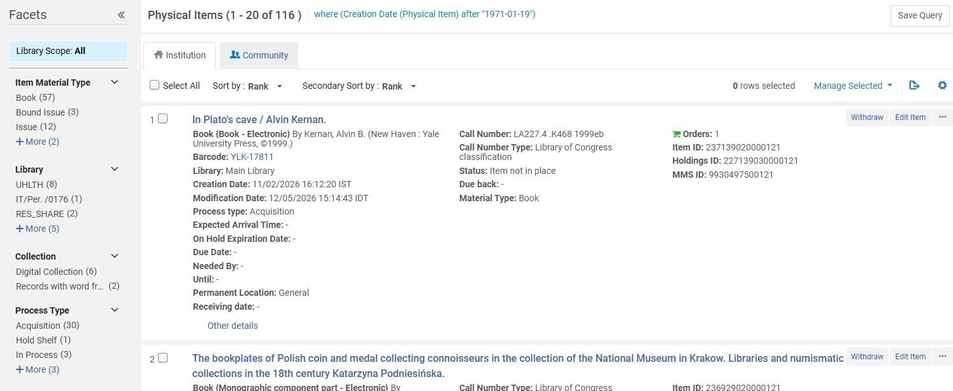
Facets
These are the facets for the physical items search in the previous User Interface.

Slide 43
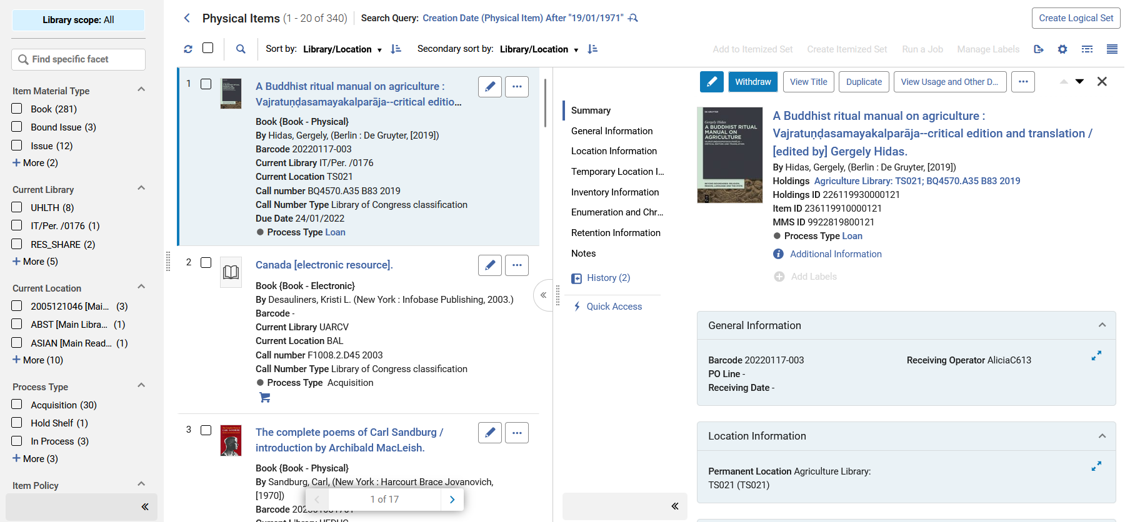
Facets
These are the facets for the physical items search in the new User Interface.
There are more down below as we will see on the next slide

Slide 44
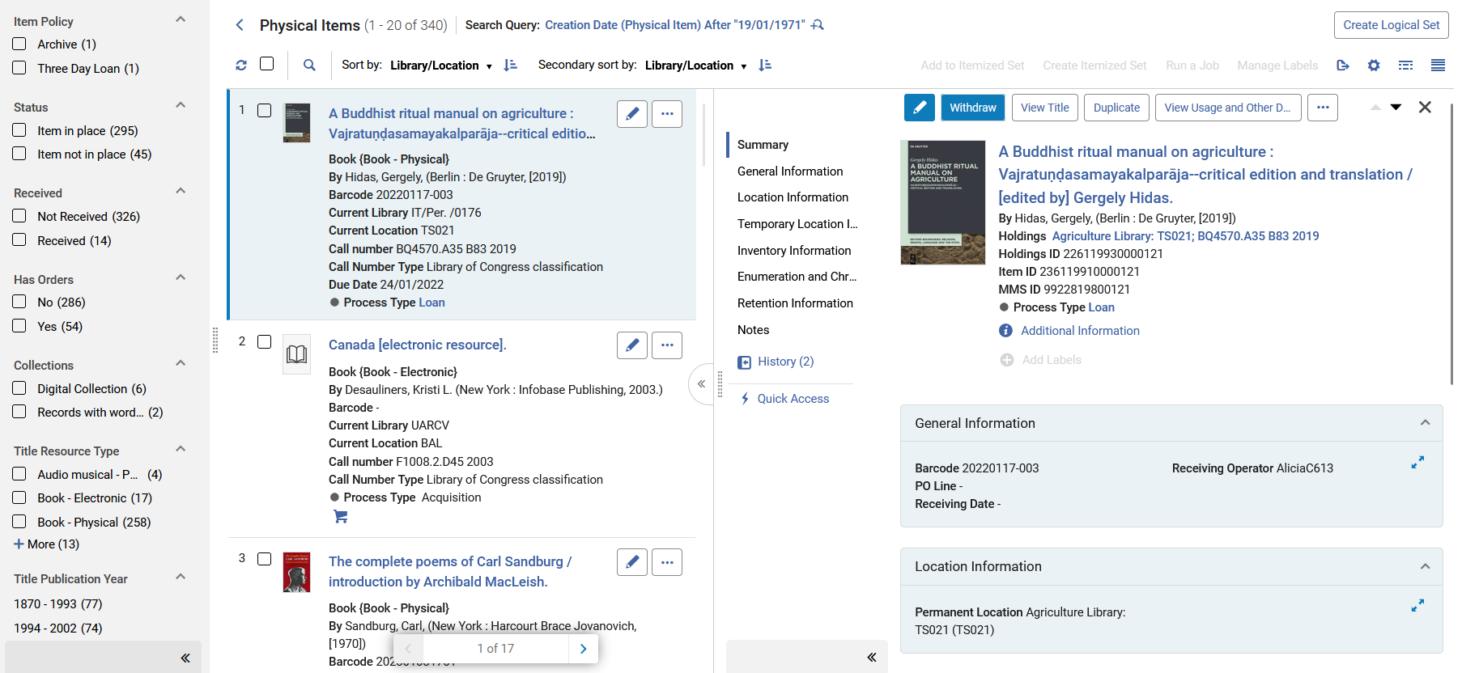
Facets
These are the facets for the physical items search in the new User Interface.
More facets which we did not see on the previous slide
There are more down below as we will see on the next slide

Slide 45
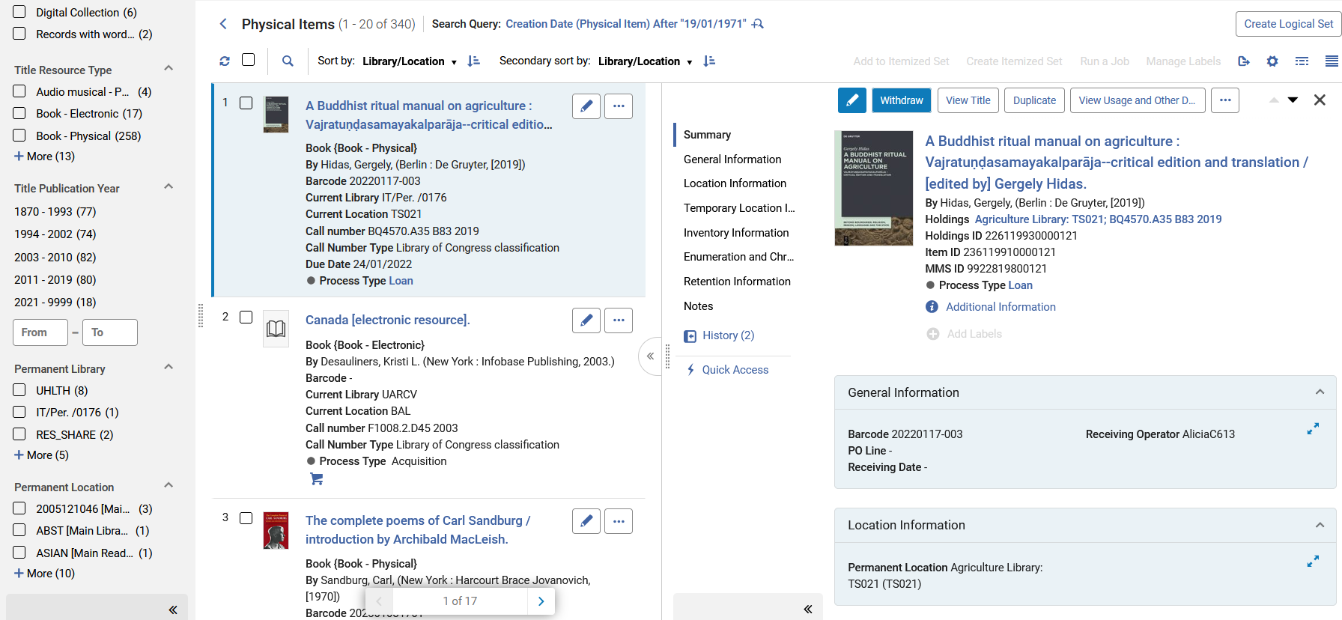
Facets
These are the facets for the physical items search in the new User Interface.
More facets which we did not see on the previous slide

Slide 46
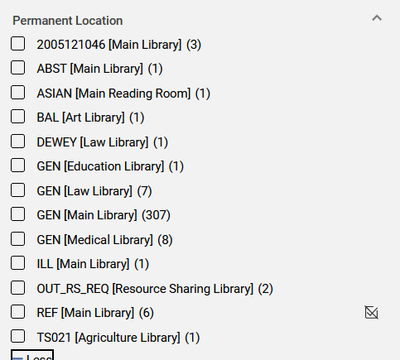
Facets
The "Permanent Location" facet includes both the library and the location.
This is useful when the same location name and / or code appears in multiple libraries,
For example, multiple libraries may each have a location "General" or "Open Stacks" or "Reserves"
Multiple libraries share the location code GEN.
Including the library name alongside the location in the facet display helps eliminate ambiguity and enables staff users to filter results more accurately.

Slide 47
Facets
Physical Items Search Facets in new User Interface compared to previous User Interface
Facets in new User Interface | Facets in previous User Interface
Item Material Type Current Library Current Location Status Received Has Orders Title Resource Type Title Publication Year Permanent Library Permanent Location | Item material Type Library Collection Process Type

Slide 48
Sorting Search Results

Slide 49
Sorting Search Results
The items search results' primary and secondary sorting were enhanced with additional sort options.
  This includes the custom Sort Routines configured by the library, which were previously available only for the Items List
  For more details, see Configuring Physical Item Sort Routines.
New Out-of-the-Box Sort Options
  Creation Date
  Modification Date

Slide 50
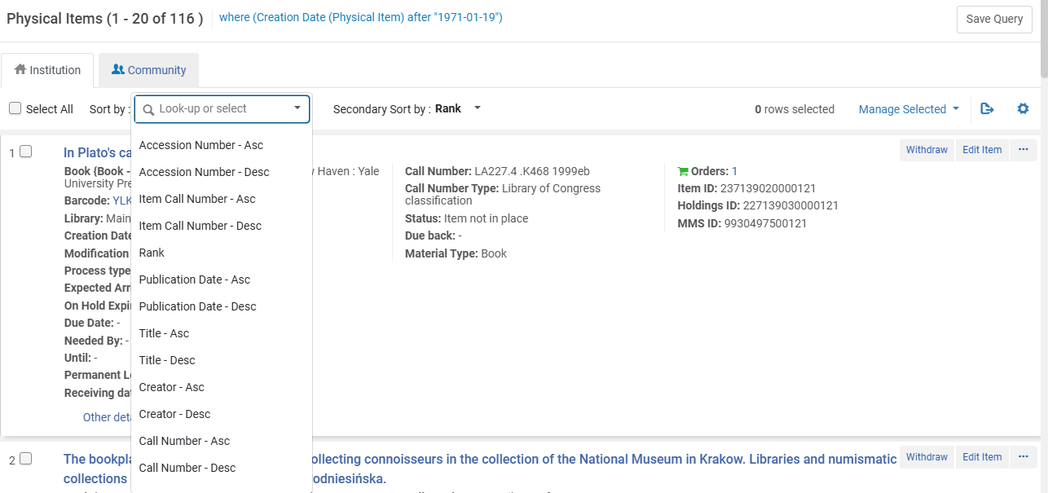
Sorting Search Results
These are the sort options in the previous User Interface
The "Ascending" and "Descending" is part of the sort routine name, making the list unnecessarily long.

Slide 51
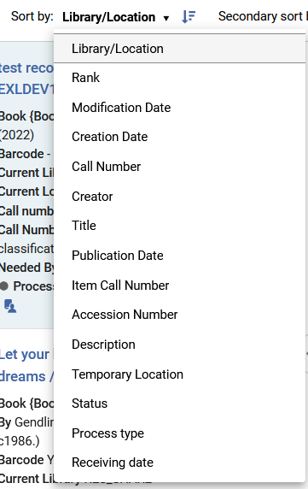
Sorting Search Results
These are the sort options in the new User Interface
The "Ascending" and "Descending" is not part of the sort routine name, but rather it is done via a dedicated :ascending / descending" button. This prevents making the list unnecessarily long.

Slide 52
Sorting Search Results
Physical Items Sort Routines in new User Interface compared to previous User Interface
Facets in new User Interface | Facets in previous User Interface
Library/Location Rank Modification Date Creation Date Call Number Creator Title Publication Date Item Call Number Accession Number Description Temporary Location Status Process Type Receiving Date | Accession Number Item Call Number Rank Publication Date Title Creator Call Number

Slide 53
Secondary Search

Slide 54
Secondary Search
The Secondary Search box allows the staff user to refine his or her search results.
This is essentially a "search within a search".
After getting the search results the staff user can perform anothyer saearech within the current search results.

Slide 55
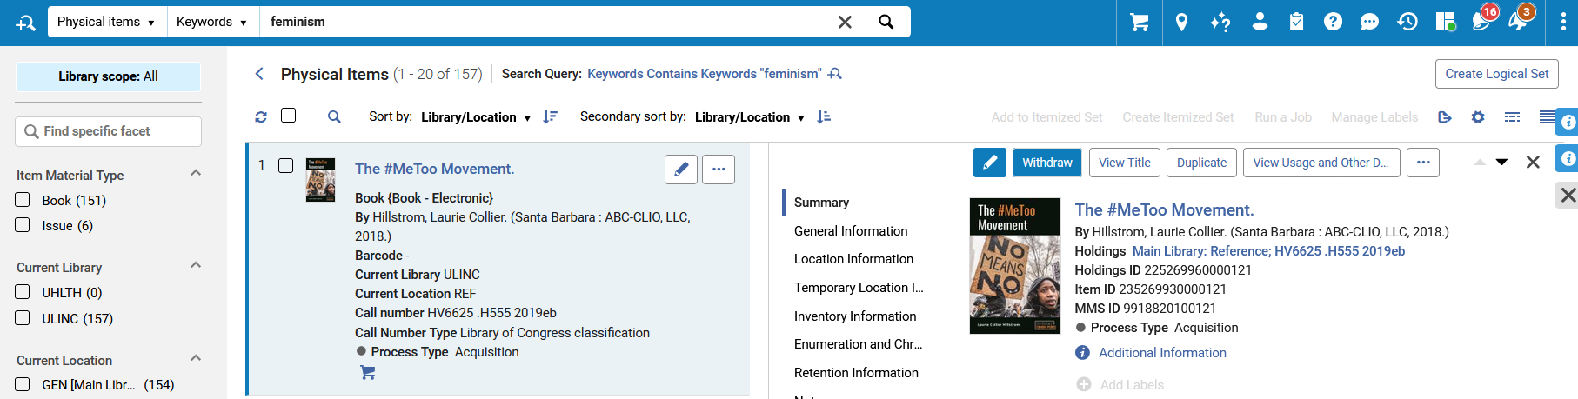
Secondary Search
Here is the new User Interface.
The staff user has performed a keyword search for "feminism".
He or she can then click the "secondary search" to search within the 157 search results.

Slide 56
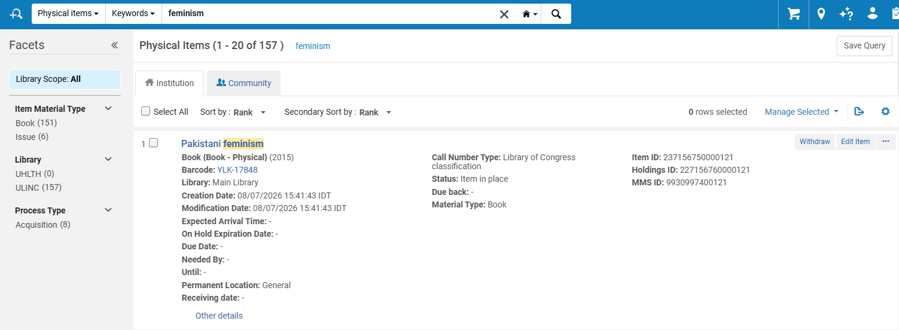
Secondary Search
Here is the previous User Interface.
The staff user has performed a keyword search for "feminism".
He or she can not then click the "secondary search" to search within the 157 search results.
To refine this search the staff user must do an entirely new search with new parameters

Slide 57
Secondary Search
Here in the new User Interface after performing a keyword search for "Feminism", the staff user wants to combine this with a keyword search for "Asian":
To refine this search the staff user will click here

Slide 58
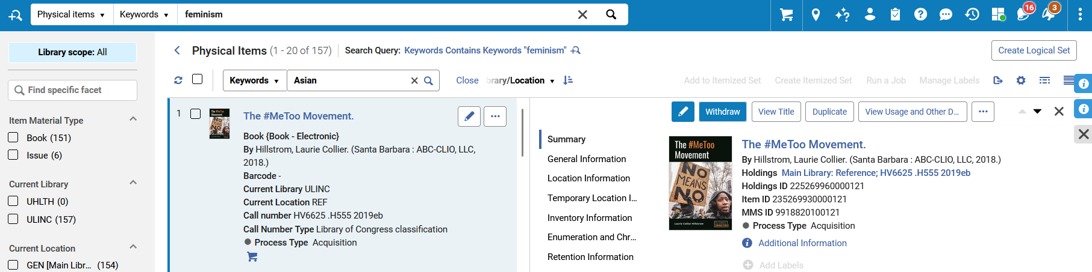
Secondary Search
Now the staff user searches for the term "Asian" within the 157 search results for "Feminism"

Slide 59
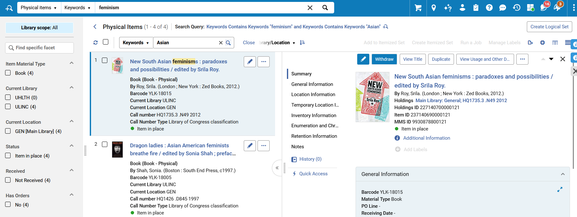
Secondary Search
Now we have a search which includes the previous search for term "Feminism" and the "search within the search results" for the term "Asian"
Of the previous 157 search results for records also have the term "Asian"

Slide 60
Labels

Slide 61
Labels
  The new Search User Interface enables institutions to define and manage local labels for their records.
  This provides greater flexibility in organizing and discovering content.
  Key Capabilities
    Add institution-specific labels to local records
    Use labels for searching, faceting, and displaying search results
    Apply or remove labels on individual records
    Perform bulk label updates on multiple records simultaneously

Slide 62
Labels
  Benefits
    Improved record organization
    More targeted searching and filtering
    Greater flexibility for local workflows and collections management
  Result: A more personalized and efficient search experience tailored to institutional needs.
  For more information see Repository Search Labels.

Slide 63
Labels
  To ensure consistent and effective use of labels, the ability to add or remove item labels is limited to authorized roles:
    Managers
    Administrators
    Physical Inventory Operators
  All users can view, search, and filter by labels, while label management remains restricted to designated roles.
  Benefit: Maintains governance and consistency while enabling all staff to leverage labels for discovery and workflow efficiency.

Slide 64
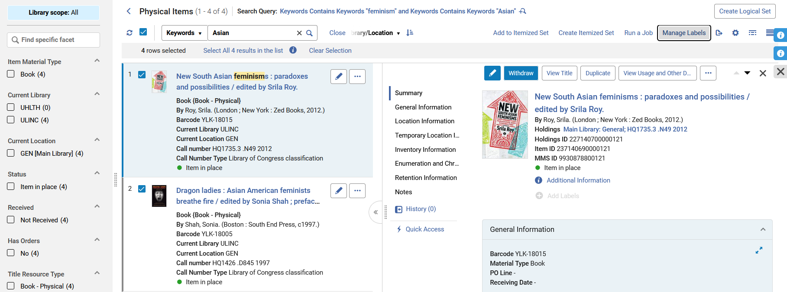
Labels
  Here the staff user will add the label "Taiwan project" to these four records which have keywords "Feminism" and "Asian"
The staff user has selected all four records and clicks "Manage Labels"

Slide 65
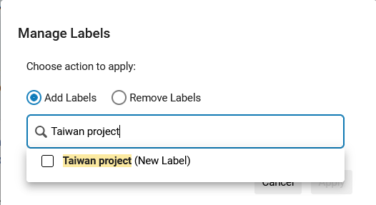
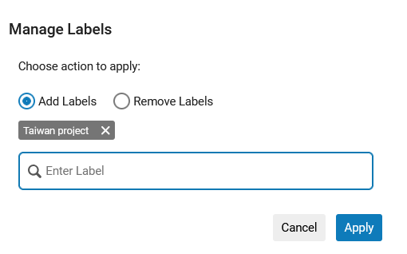
Labels
  The staff user adds the label

Slide 66
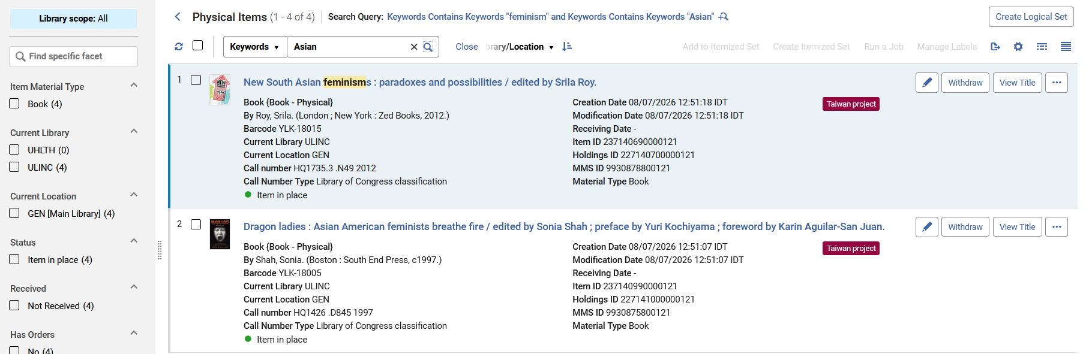
Labels
  The label has been applied to all selected records

Slide 67
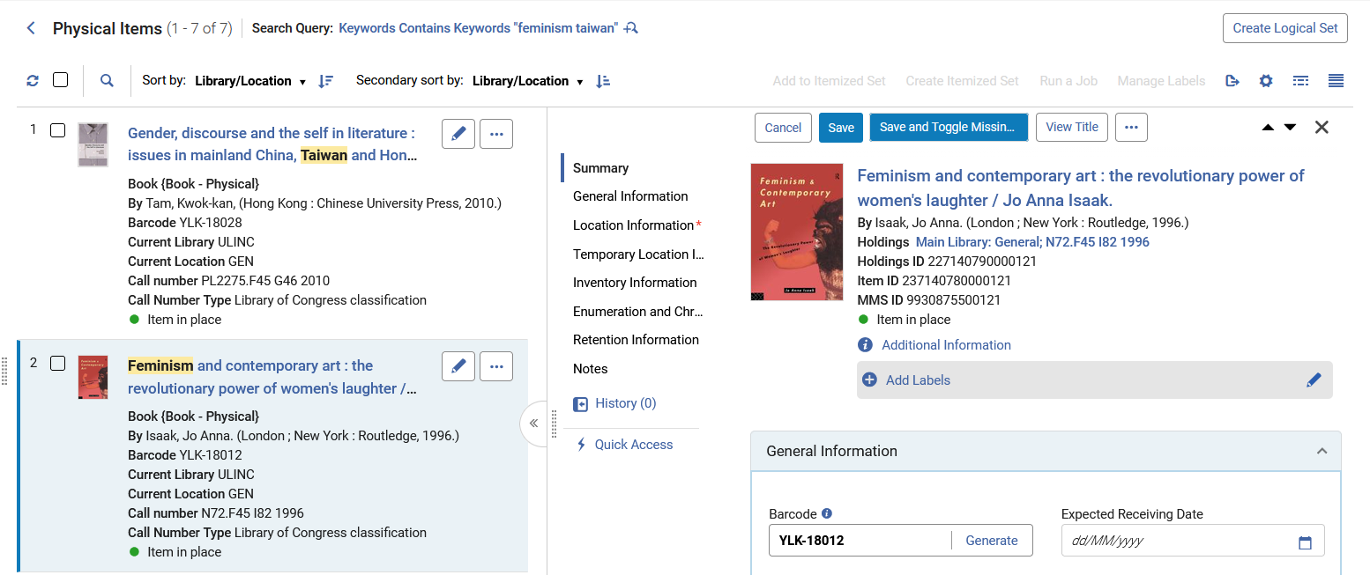
Labels
  The labels can also be added one at a time by editing the item and adding a label.

Slide 68
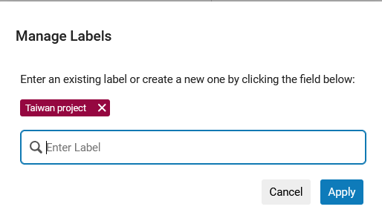
Labels
  The staff user chose the existing label "Taiwan project" and will add it to the item.

Slide 69
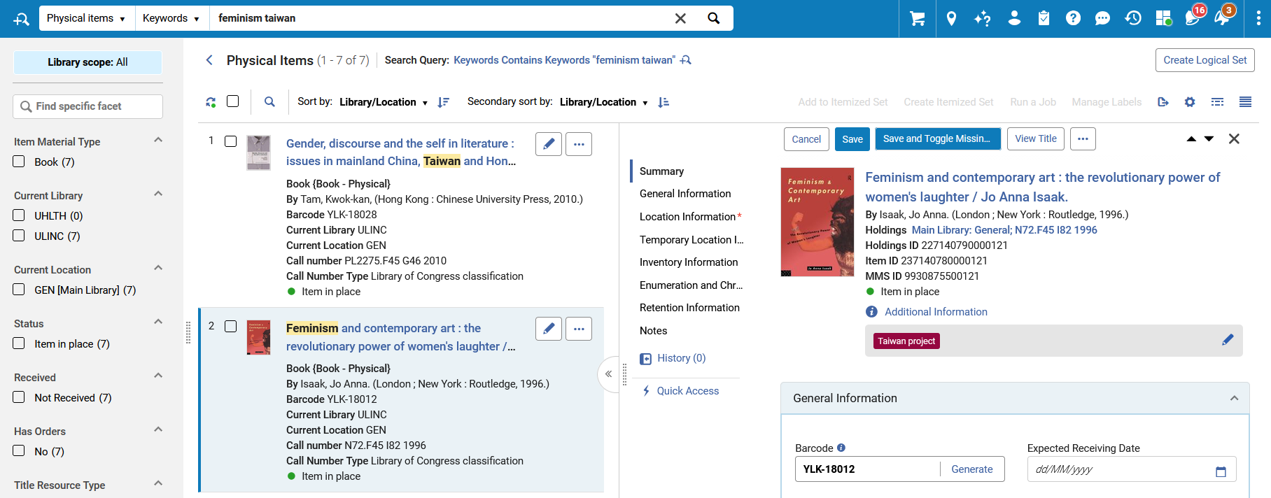
Labels
  The label as been added

Slide 70
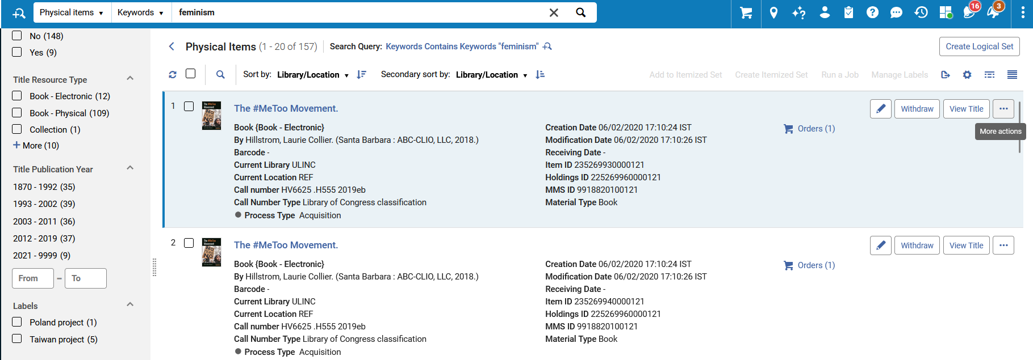
Labels
  The physical item search results can be faceted by the labels

Slide 71
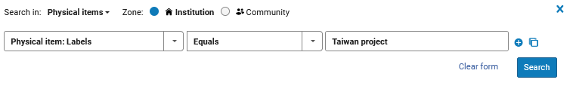
Labels
  Note that it is also possible to search by the labels.
  Here were performing a physical items advanced search and search by "Physical Item: Labels = Taiwan Project".

Slide 72
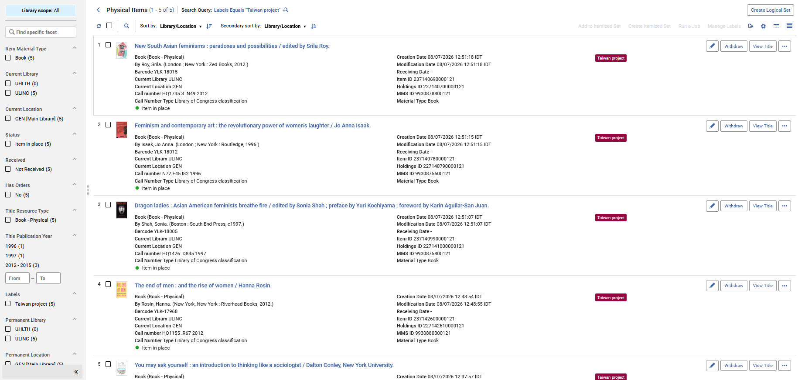
Labels
All search results have label "Taiwan project"

Slide 73
The Holdings' Items List

Slide 74
The Holdings' Items List
The holdings' item list can be accessed in multiple ways. Here is one example:
Perform an "all titles" search
If the physical inventory is not already expanded, then expand it
Choose "Action Items > View Items" for one specific holdings record

Slide 75
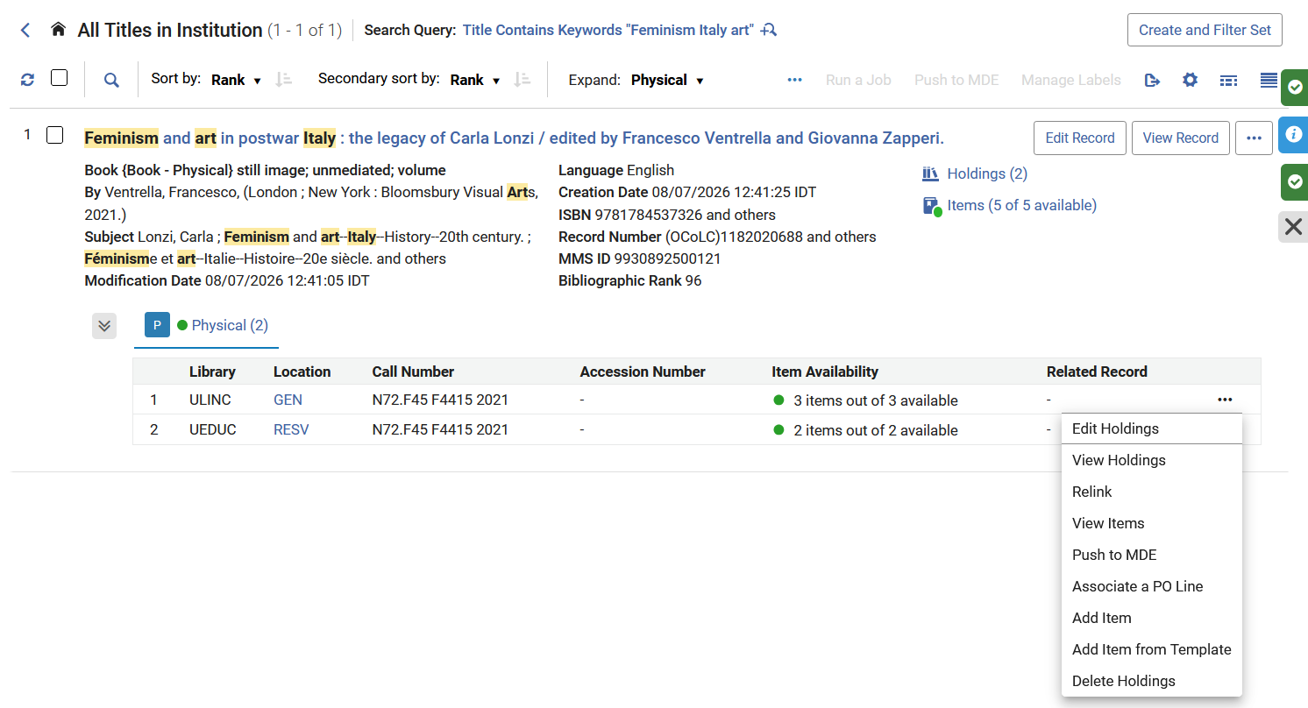
The Holdings' Items List
The holdings' item list can be accessed in multiple ways. Here is one example:
There are 5 items in 2 holdings records
Physical Inventory is Expanded
Choose "Action Items > View Items"

Slide 76
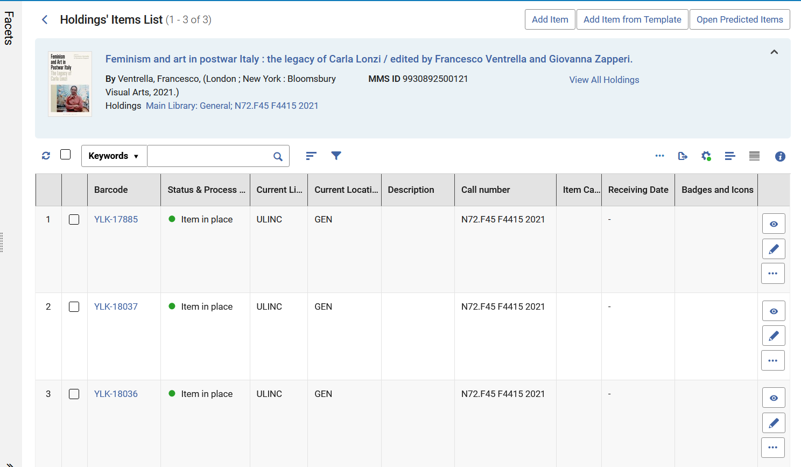
The Holdings' Items List
Arrive to the Holdings' Items List
These are 3 items in 1 holdings record

Slide 77
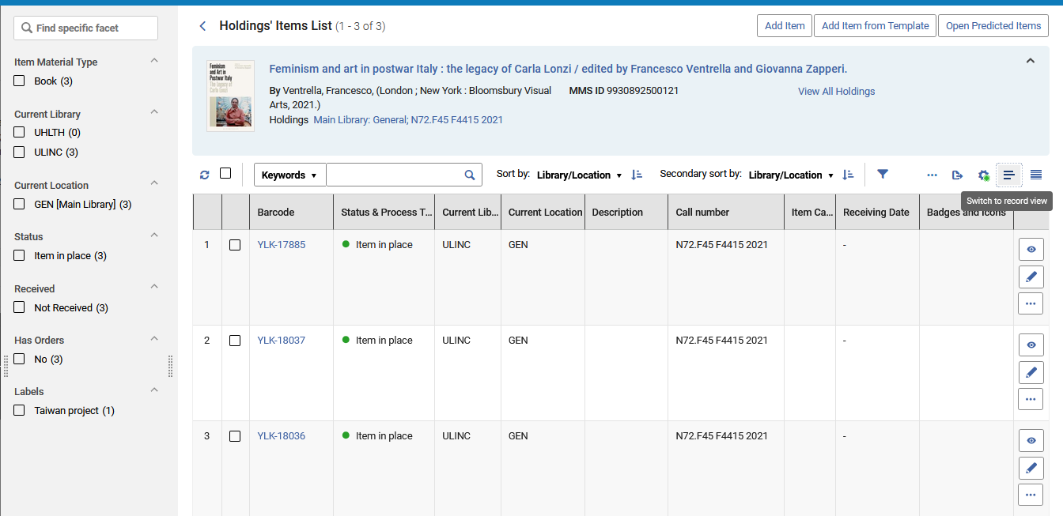
The Holdings' Items List
In the Holdings' items list the staff user can switch between the default table view and the record view

Slide 78
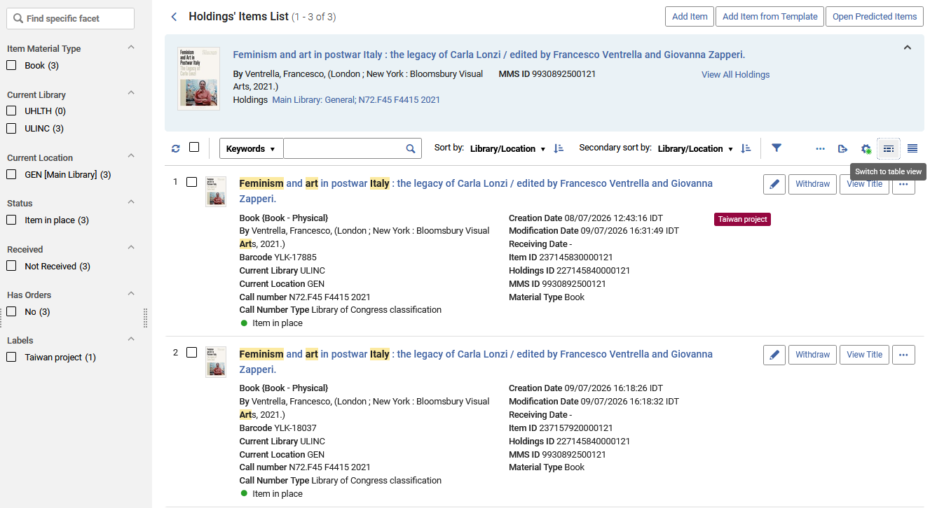
The Holdings' Items List
Now we are in the record view and can switch back to the table view.

Slide 79
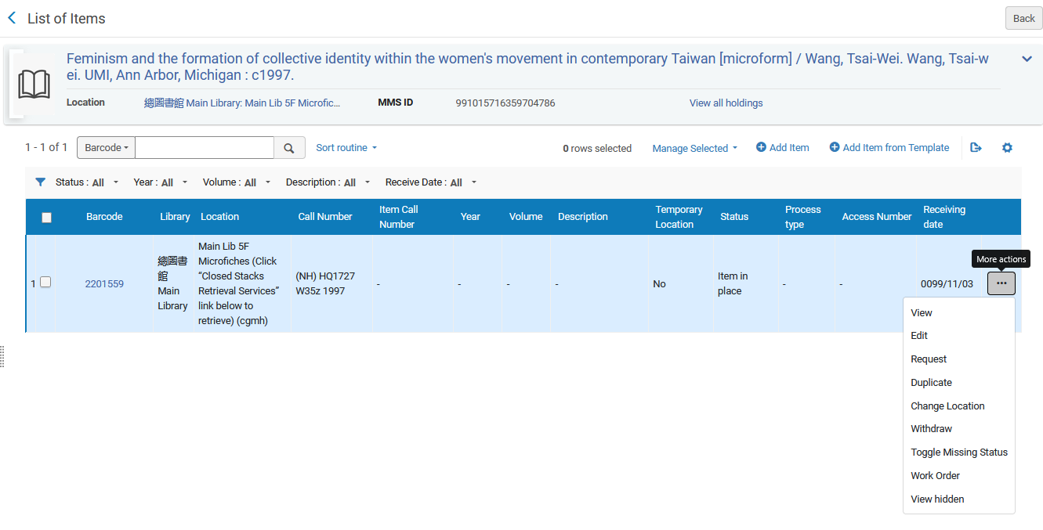
The Holdings' Items List
These are the actions that the staff user could take on each item on the previous user interface Holdings' list of items

Slide 80
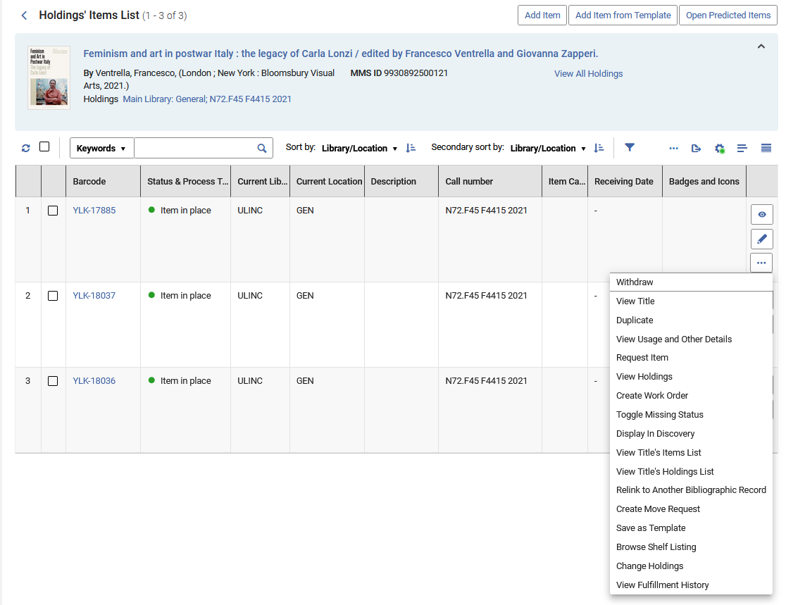
The Holdings' Items List
These are the actions that the staff user can take on each item on the new user interface Holdings' list of items

Slide 81
The Holdings' Items List
Actions the staff user can take on each item from the holdings' list of items
Previous User Interface | New User Interface
View Edit Request Duplicate Change Location Withdraw Toggle Missing Status Work Order View Hidden | View Edit Withdraw View Title Duplicate View Usage and Other Details Request Item View Holdings Create Work Order Toggle Missing Status Display In Discovery View Title's Items List View Title's Holdings List Relink to Another Bibliographic Record Create Move Request Save as Template Browse Shelf Listing Change Holdings View Fulfillment History

Slide 82
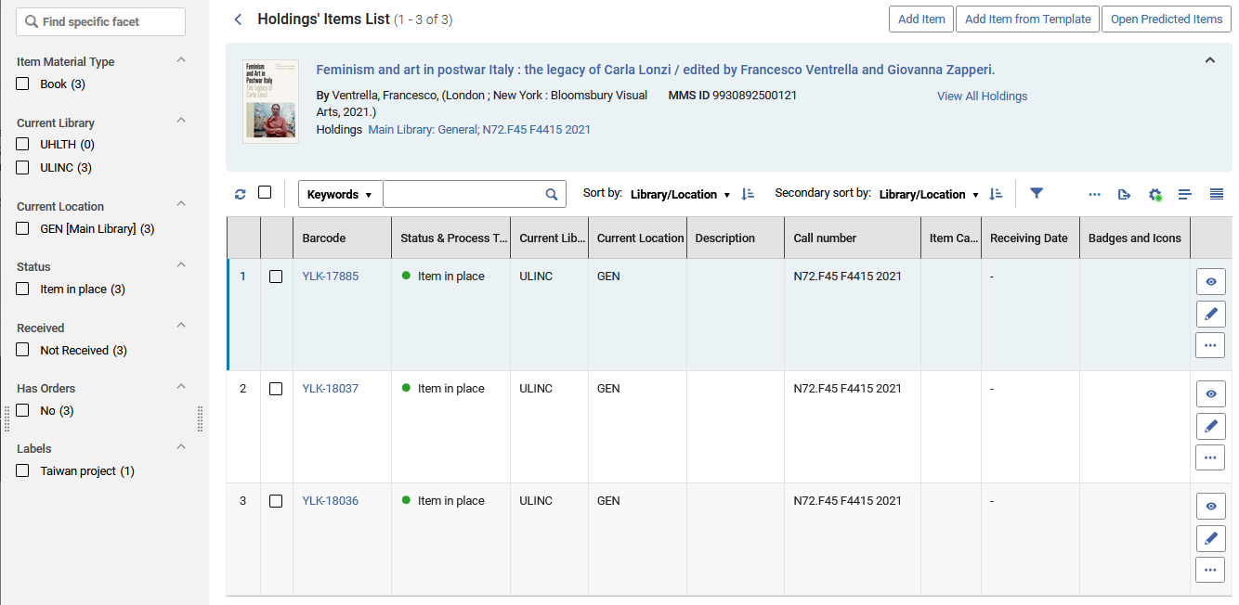
The Holdings' Items List
Clicking "View" or "Edit" on an item in the Holdings' item list opens the item in the same window on the side, hence the staff use does not lost context of where he or she is working
We will click "View"

Slide 83
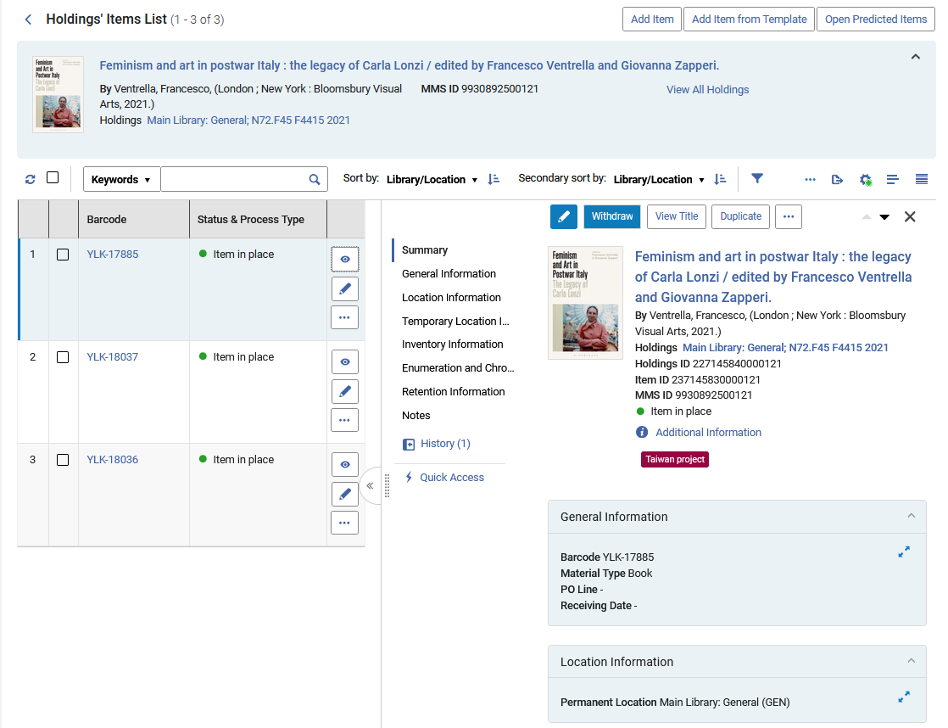
The Holdings' Items List
The item opens in the same window on the side

Slide 84
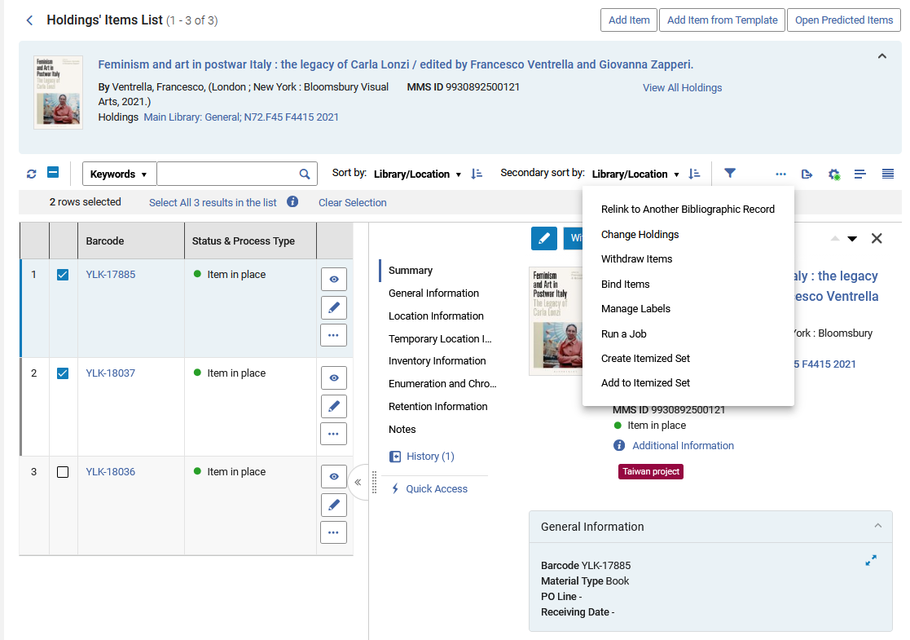
The Holdings' Items List
The holdings' items list offers additional bulk actions on selected items, such as binding, opening predicted items and more.

Slide 85
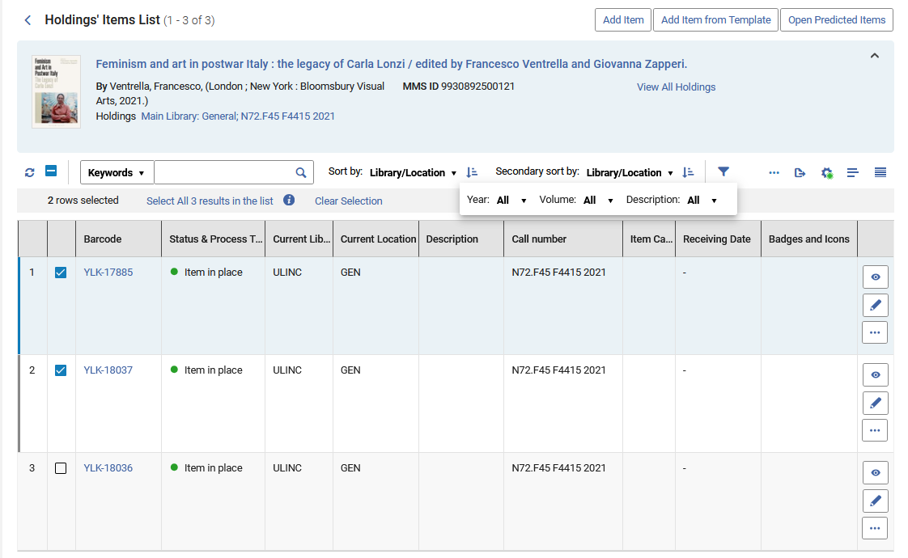
The Holdings' Items List
The holdings' items list can be filtered by Year, Volume and Description

Slide 86
The Title's Items List

Slide 87
The Title's Items List
The title's item list can be accessed in multiple ways. Here is one example:
Perform an "all titles" search
Click the "Items" link

Slide 88
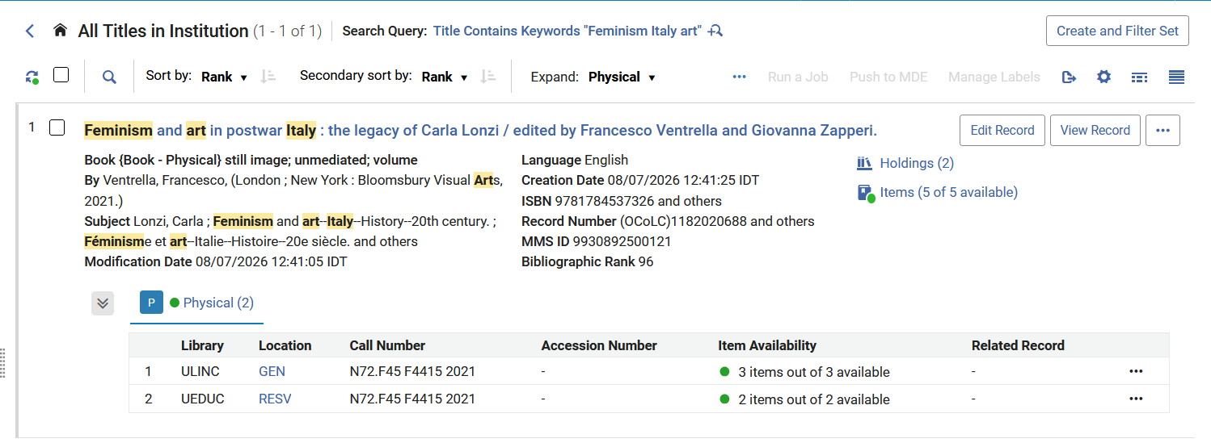
The Title's Items List
The titles' item list can be accessed in multiple ways. Here is one example:
Click the "Items" link
There are 5 items in 2 holdings records

Slide 89
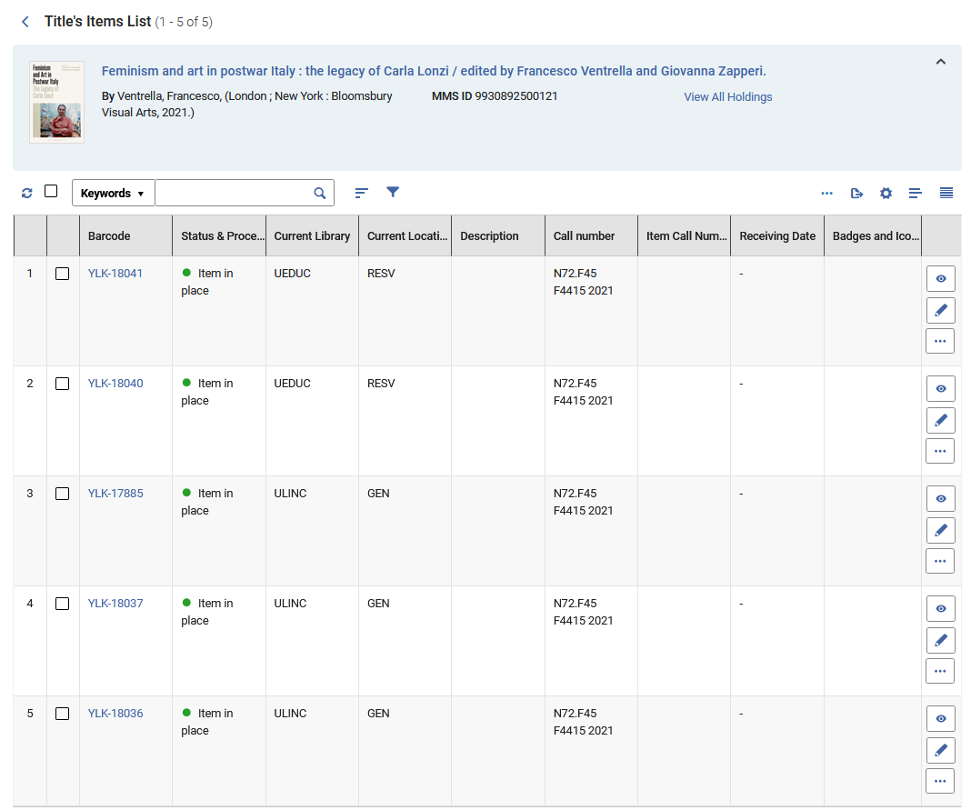
The Title's Items List
Arrive to the Title's Items List
These are 5 items in 2 different holdings records

Slide 90

The Title's Items List
In the Title's items list the staff user can switch between the default table view and the record view

Slide 91

The Title's Items List
Now we are in the record view and can switch back to the table view.

Slide 92

The Title's Items List
These are the actions that the staff user could take on each item on the previous user interface Title's list of items

Slide 93

The Title's Items List
These are the actions that the staff user can take on each item on the new user interface Title's list of items

Slide 94
The Title's Items List
Actions the staff user can take on each item from the Title's list of items
Previous User Interface | New User Interface
View Edit Request Duplicate Change Location Withdraw Toggle Missing Status Work Order View Hidden | Edit Withdraw View Title Duplicate View Usage and Other Details Request Item View Holdings Create Work Order Toggle Missing Status Display In Discovery View Title's Holdings List Relink to Another Bibliographic Record Create Move Request Save as Template Browse Shelf Listing Change Holdings View Fulfillment History

Slide 95
The Title's Items List
Clicking "View" or "Edit" on an item in the Title's item list opens the item in the same window on the side, hence the staff use does not lost context of where he or she is working
We will click "View"

Slide 96

The Title's Items List
The item opens in the same window on the side

Slide 97

The Title's Items List
The title's items list can be filtered by Year, Volume and Description

Slide 98
Configurable Display

Slide 99
Configurable Display
Configurable Item Information Layout
  Item information is now organized into clear sections to improve usability.
  Related fields are grouped together, such as Description, Enumeration, and Chronology.
  Users can configure the order of sections based on their workflow needs.
  Frequently used sections, such as Enumeration and Chronology Information or Retention Information, can be placed at the top for quicker access.

Slide 100

Configurable Display
Note that currently "Call Number" and "Call Number Type" are on the bottom of the left column.
We want to move them to the top of the left column.

Slide 101

Configurable Display
We have performed a physical items search and will now click "Customize"

Slide 102

Configurable Display
On our example, under "User Customization" we will click "Records Customization"

Slide 103

Configurable Display
Here is what we have, and we will drag "Call Number" and "Call Number Type" up to the top.

Slide 104

Configurable Display
We have dragged the "Call Number" and "Call Number Type" up to the top.

Slide 105

Configurable Display
Now the "Call Number" and "Call Number Type" are at the top.

Slide 106


Configurable Display
before
after

Slide 107
The New Item View

Slide 108
The New Item View
New Condensed Item View
  Presents item details in a streamlined, easy-to-read format.
  Key information is displayed in a compact layout to improve usability.
  Sections can be expanded as needed to view additional details.
  Provides quick access to essential information while minimizing screen clutter.

Slide 109

The New Item View
Key information is displayed in a compact layout to improve usability
We will expand this section to view additional details

Slide 110

The New Item View
Now the section is expanded
The section can now be collapsed

Slide 111
Editing An Item

Slide 112
Editing An Item
New Item Editor
Supports both side-by-side and full-page item editing.
Available from the new Search and New Items List, with additional workflows (such as the Receiving Workbench) using a sliding panel experience.
Provides access to all item fields in a single editor, eliminating the need to switch between tabs.
No more "Save and Edit" steps to update additional fields on newly created items.
Quickly navigate through item information by scrolling, using the section menu, or selecting fields directly from the Quick Access panel.

Slide 113

Editing An Item
This is side-by-side item editing

Slide 114

Editing An Item
This is full-page item editing
The physical item editor displays all fields on a single screen, allowing staff users to scroll (or use the sections or quick access links) seamlessly through item details. There is no need to switch between tabs to locate or update a specific field.

Slide 115

Editing An Item
This is full-page item editing
Staff users can quickly navigate the editor using the sections links

Slide 116

Editing An Item
Staff can also use the "Quick Access" to go directly to a specific field
We want to go directly to the "Receiving Date"
Here we clicked the "Quick Access"

Slide 117

Editing An Item
The cursor and focus have moved directly to the Receiving Date
This is the field we selected from the Quick Access

Slide 118

Yoel Kortick
Yoel.Kortick@clarivate.com
About Clarivate
Clarivate is a leading global provider of transformative intelligence. We offer enriched data,
insights & analytics, workflow solutions and expert services in the areas of Academia & Government, Intellectual Property and Life Sciences & Healthcare. For more information, please visit clarivate.com.
© 2026 Clarivate. All rights reserved
Clarivate and its logo, as well as all other trademarks used herein are trademarks of their respective owners and used under license.

