Slide 1
Influenza Diabetes Community
Prevention and Best Practices
Inaction is no longer an option.
It is time for health equity now.
Notes:
The current health pandemic and its disproportionate toll on minority, low-income, and historically underserved Americans shine a troubling light on historic, systemic inequities.

Slide 2
Diabetes in the U.S., By the Numbers
122 Million Americans are living with diabetes or pre-diabetes
40% of Americans who have died of COVID have had diabetes, though the condition affects just 10% of the U.S. population
43% of Americans with diabetes say they have delayed seeking routine medical care during the pandemic

Slide 3
In the US, Black communities bear a disproportionate burden of COVID-19 and serious influenza (flu) illness and related outcomes, along with historically lower flu vaccination rates.
This NFID-sponsored survey was conducted by NORC at the University of Chicago, in December 2020.

Slide 4
Health Equity Bill of Rights
No matter people’s race, income, geography, age, education, or gender—they deserve equal access to the most basic of human rights: their health.
Created by the American Diabetes Association, Health Equity Bill of Rights establishes ten basic rights for people with diabetes and prediabetes, to promote their human right to health.
#HealthEquityNow
Health equity is a human right. We must solve it together.
Now is the time.
Notes:
Inequity systemically harms people of color. Health inequity is obvious and widespread. It contributes to worse outcomes and higher risk for diabetes and many other diseases. And it undermines the wellbeing of our most underserved communities.

Slide 5
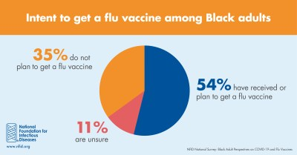
According to recent study, majority of U.S. Black adults believe vaccination is the best protection against flu and have received or plan to get a flu vaccine
This NFID-sponsored survey was conducted by NORC at the University of Chicago, in December 2020.

Slide 6

THE BIG QUESTION: ADOPTION

Slide 7



Problems to be Solved
Trust: belief in the reliability, strength, ability of services/programs
Education/Knowledge: Formal learning and acquiring facts, info, skills through one's experience
Notes:
TRUST:
Lack of trust in science/health care due to historical trauma
Lack of trust in perceived safe, caring, and empathetic systems in the community
Lack of trust, connection for Person with Diabetes (PWD) with provider
Limited visibility of providers within the community
EDUCATION:
Lack of knowledge around historical disparities and interconnected systemic inequities
Lack of diverse modalities of delivering health education/modification of services provided
Continued prevalence/belief in implicit bias with healthcare providers
Lack of knowledge around complex systems (insurance, technology, financial resources)

Slide 8
HealthEquityNow Insights | Trust
Insight | Explanation & Supporting Data
A disconnect and perceived power imbalance between healthcare providers, particularly physicians, and community members exists | “The breakdown in transparency, lack of confidence in the information and resources provided, and providers lack of presenting real solutions increases the wall of distrust making penetrating the community more difficult”
There is a belief that the responsibility for change rests solely with the patient rather than a working, cooperative relationship with healthcare providers | Communication is primarily one sided with the PWD receiving information from care providers with assumption of compliance.
There’s a mistrust of perceived safe, caring, and empathetic systems in the community. | Community wants leaders, coaches, teachers, pastors to be part of the care plan. They want flexibility in the provider model to meet people where they are

Slide 9
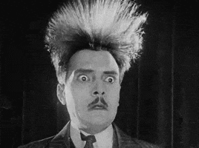
FRICTION
Notes:
Include Motivational Interviewing as the solution to Friction.

Slide 10
Remove cost barrier
Bring it to the people
Build trust
Use community leaders
Let people see people like them
MAKE IT EASY

Slide 11
A collaborative, goal-oriented style of communication …to strengthen personal motivation for and commitment to a specific goal by eliciting and exploring the person’s own reasons for change within an atmosphere of acceptance and compassion.
- Miller & Rollnick (2021)
Better Communication:
Motivational Interviewing

Slide 12
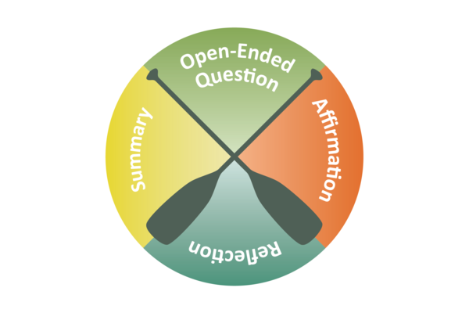
OARS Method

Slide 13

Which approach might be most effective?
1. You must get vaccinated!
3. Do you mind if we talk about the flu vaccination?
2. Only an idiot would not get vaccinated.
4. What do you want to know about the vaccine?

Slide 14
Knowledge
Trust
Friction

Slide 15


