Slide 1
Protecting against flu
Education for people with diabetes

Slide 2
Declaration
Diabetes UK works with pharmaceutical companies who share our vision of a world where diabetes can do no harm.
We maintain our independent voice in all partnerships
We do not endorse or promote the use of any pharmaceutical therapy above and beyond the evidence base.
Influenza Vaccination = ‘flu jab’

Slide 3
2020-21
A year like no other for flu

Slide 4
Flu and diabetes
Why we protect
People with diabetes at greater risk of flu and its severe complications
Longer hospital stays, increased risk of diabetes complications and death
[1,2,3]

Slide 5
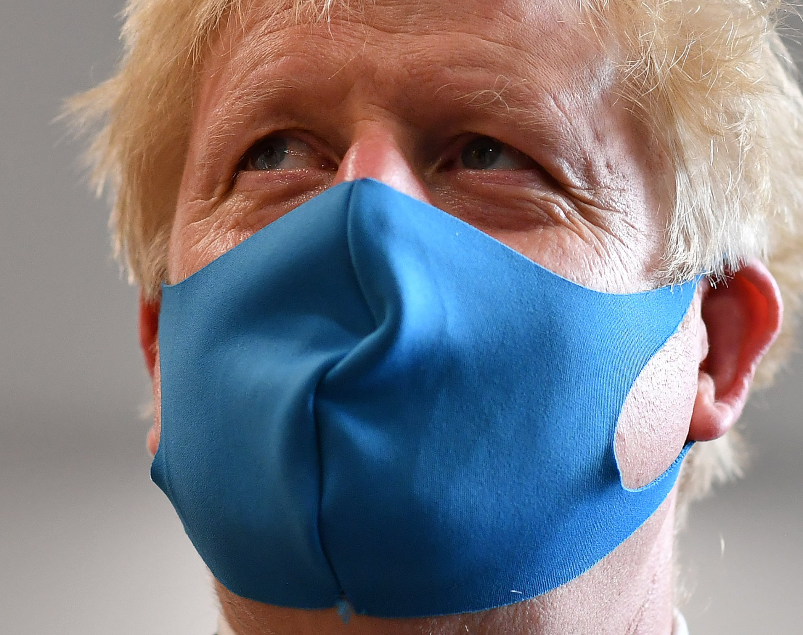
2020 a novel year
Coronavirus and flu
Extraordinary position statement
National restrictions/universal precautions
HOWEVER misconceptions around flu jab still exist

Slide 6
2020 flu jab season
People knew they needed to keep safe
Overwhelming NHS pressure and gratitude to the hard working NHS staff
Cohort of people receiving free flu jab widened.
People with diabetes continue to receive free flu jab
? People with diabetes well enough?

Slide 7
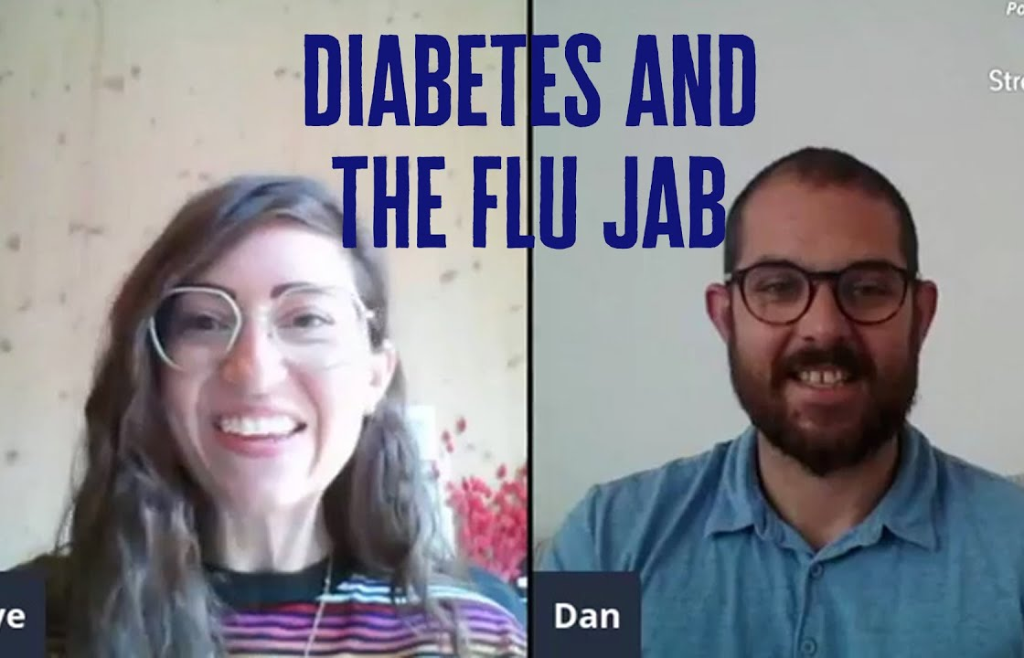
Diabetes uk proactive approach
Providing information
Social media post.
Letters of encouragement in newspapers
Press attention for position statement
Worked with NHS to share information
Encouraged partners to adopt our positions

Slide 8
Partners
Adopting our position
Appointments for the flu jab made early for those at risk
Educational information alongside the flu jab
Social media information shared

Slide 9
HOW DID WE DO?

Slide 10
Flu jab uptake 2020?
Surveys indicated an increased uptake of flu jab in general population
Annually people with diabetes have a relatively high uptake of the flu jab in the UK
Low rates of flu due to various factors (lockdown/restriction)

Slide 11
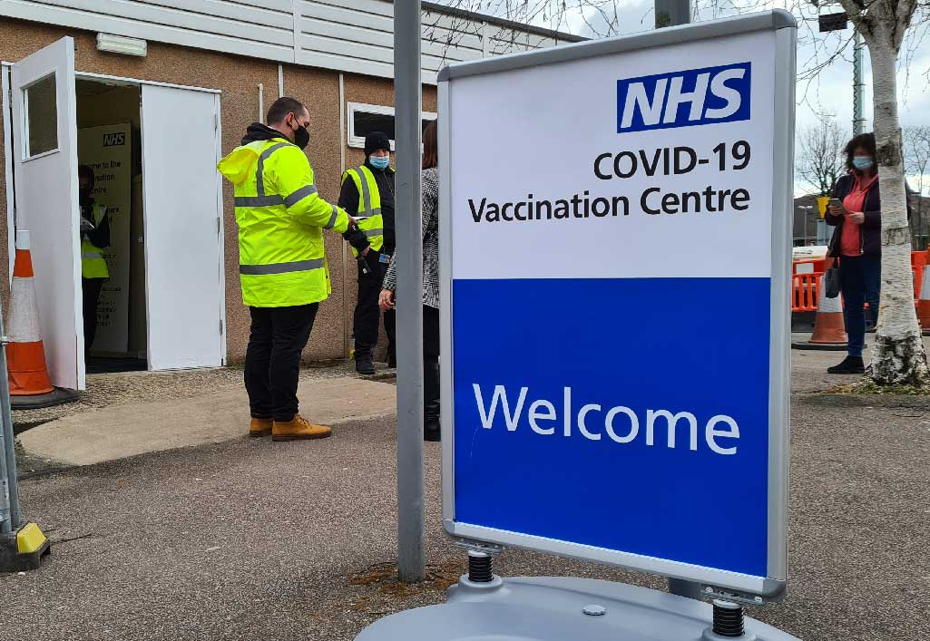
New vaccine on the block
Diabetes UK support vaccines
December 2020 saw the roll out of the CV19 vaccine
People with diabetes remained a priority in the NHS
Diabetes UK represented on JCVI meetings
Continue to provide education

Slide 12

Next
2 year review
Flu jab uptake figures available next year to see impact.
Diabetes UK continue to provide flu jab education

Slide 13
Thank you

